Slide 1
Combine Collaboration
and Innovation
Voila!
A Recipe for Success
Ingredients: Collaborating Partners
Success: Innovating Ideas
April 2017

Slide 2
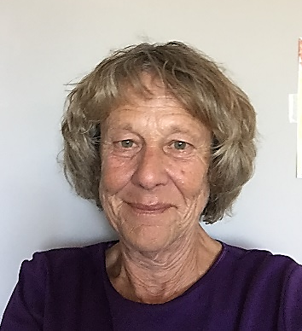
Welcome & Introductions
Pat Thomas, Director
Southwest Adult Basic Education (SW ABE)
Pat has been an ABE Director for 17 years in southwestern Minnesota. She began the FastTRAC journey with its inception and continues working to make it a more effective tool for ABE learners.
pthomas @starpoint.net

Slide 3
Judy Mortrude
Senior Policy Analyst, Center for Postsecondary and Economic Success; Clasp Director, Alliance for Quality Career Pathways

Slide 4
Career Pathway On-ramp
An on-ramp is a career pathway program designed to serve individuals with significant barriers to educational and economic success.
Notes:
Federal definitions of CP: WIOA and HEA
Interplay with POS/CP
Case study from MN
Share some models

Slide 5
Notes:
Current state of MN work under WIOA –
Still confusion for some and still a lot of concern in the community that the model isn’t working for everyone.
MSPWin – workforce collaborative – convening community of practice (Equity Works!), advocating for co-investment of state and federal funds for career pathways, driving the equity agenda
Survey, focus groups, interviews, written report – here’s some of the basics from that research:

Slide 6
Target Populations for On-Ramps
Notes:
On-ramps report
Survey
Focus groups
F

Slide 7
Stabilization & Supportive Services
Mental health counseling
Physical health services
Food security
Stable housing
Income supports, financial support
Justice involvement – expungement, re-entry
Debt reduction
Family services
Career navigation
Incomes supports
Childcare
Transportation
Accommodation of learning disability
Work supports – EITC, cash assistance
Intensive screening
Housing assistance
Financial coaching and education
Domestic violence services
Traditional cultural support

Slide 8
Integrated Education & Training
College & career readiness
Workforce preparation, employability skills
Resiliency competencies
Work-based training
Workforce training
Recognized post-secondary credential
Coaching

Slide 9
Employment, Retention & Reengagement
Work experience
Temporary work
Part-time work
On the Job Training
Transitional Jobs
Pre-apprenticeship
Apprenticeship
Job Development and Placement
Post-employment Retention
Post-employment Advancement

Slide 10
Beyond Program Delivery
Partners: who bring resources and are responsible for outcomes
Funding: diversity of funds and continuity of funds
Data: for both continuous improvement and performance evaluation
Risk Adjusted Measures: don’t ‘disincent’ serving neediest
Barriers: organizational and structural

Slide 11
Notes:
International Institute of Minnesota has helped immigrants and refugees resettle in Minnesota for nearly 100 years. Well-known medical career pathways program: CNA, phlebotomist, LPN, RN, now has one of their graduates as nursing instructor with the St Paul Community College
Looking for solution for low-literate Somali refugees. Needed employment and benefits – houskeeping partnership with several large hotel chains. Negotiated job quality factors for their students.
I. Stabilization & Supportive Services
Refugee resettlement includes full family supports in community services including furnishing an apartment, enrolling children in school, connecting to health services, learning transportation systems and immigration and citizenship services. IIMN is also a WIOA Adult Basic Education provider and an employment trainer.
II. Integrated Education and Training (IET)
While well-known for their medical career pathways, this IET program was started in response to participants' needs for attaching to full-time work with benefits without high levels of academic preparation.
Hotel Housekeeping Class 6-week, 100-hour class trains prospective hotel housekeepers in customer service, industry-specific English, housekeeping skills, and soft skills. Students receive workers’ safety and speed training.
III. Employment, Retention, and Re-engagement
IIMN actively works with employers, advocating for livable wages for program completers, and both helping employers take advantage of tax incentives for hiring their participants and improve employers’ abilities to work well with these new hires through courses tailored to employers: Communication with ESL employees; Working with Diversity.
Housekeeping Supervisor Training We help experienced, working housekeepers gain the skills needed to move into a supervisory or training position. Through classes and collaborative workshops with our Hotel Housekeeping class, students will learn positive feedback and teaching techniques as well as develop supervisory skills.
Hotel Management Bridge and Support Course 3-week class and ongoing support during first college semester For clients who want to pursue a degree in hospitality management at Normandale Community College This course is designed to prepare students currently working in the hospitality industry for college-level courses in hotel department management. Students will gain industry-specific skills such as critical thinking, college writing, and technological fluency to support them in pursuing a college degree in hospitality management.

Slide 12
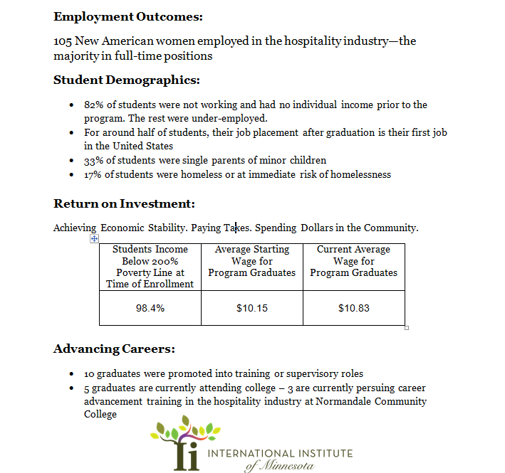

Slide 13
Thanks!
Defining On-Ramps to Adult Career Pathways
http://www.clasp.org/resources-and-publications/publication-1/Minnesota-Career-Pathways-On-Ramps.pdf
Integrated Education and Training: Model Programs for Building Career Pathways for Participants at Every Level
http://www.clasp.org/resources-and-publications/publication-1/WIOA-IET-Model-Programs.pdf
Judy Mortrude
jmortrude@clasp.org

Slide 14
What do Collaboration Partners look like?
Minnesota
Judicial
Branch
MN House of Representatives

Slide 15
Definition of collaborate
collaborated; collaborating
1: to work jointly with others or together especially in an intellectual endeavor.
2: to cooperate with or willingly assist an enemy of one's country and especially an occupying force
3: to cooperate with an agency or instrumentality with which one is not immediately connected.

Slide 16
Litmus Test for Collaboration
Do you have the right combination of sweet, sour, acid and spice?
Do you function differently due to your collaboration?
Where is your focus?
Can you operate “as a work in progress” or like you are creating a recipe as you go along?
How much do you set as a priority in the creation of relationships outside your agency?

Slide 17
True collaboration requires all parties to be willing to adapt by changing their normal operating procedures.
If the food processor does not work, bring out the blender.
Examples:
Legislative grant to provide career navigating
Community College Customized Training Director grants
Schedule for Career Pathway trainings done with youth.

Slide 18
Keep your focus on the completed dessert
The student’s success is our focus - whether adult or youth.
“Wherever a student is in life’s journey when he or she enters our program,
that individual will move forward to find success.”

Slide 19
If you only focus on your program goals,
you miss many opportunities—opportunities captured when creating a more diverse menu for the common customer.
Care Provider and potential legislative funding to create an online literacy-based curriculum for healthcare workers.
Financial support from healthcare facility to offer CNA trainings.
Changing state law to get reimbursement for CNA trainings.

Slide 20
Real collaboration takes flexibility and an ability to adapt quickly. It is like having to come up with a meal using surprise ingredients.
Examples:
Learning thru Sharing tapping into WorkForce for mock interviews
Utilizing a high school alternative program to help students attain a diploma
Sharing a teacher with the National Head Start training agency

Slide 21
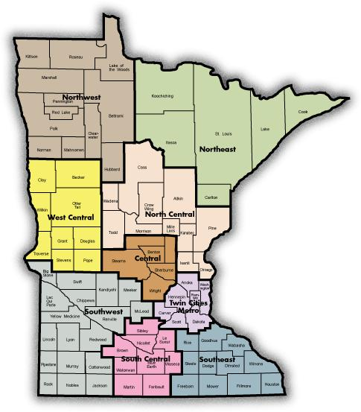
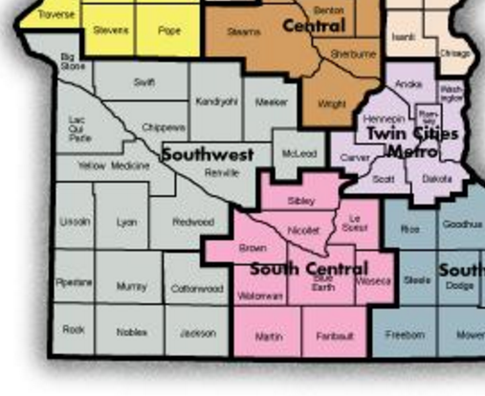
Where the “cooking” is happening
Southwest
Minnesota

Slide 22
What SW Minnesota has to offer
Primary Industry Sectors
Agriculture Healthcare
Manufacturing Energy
Transportation Finance/Banking
Government Food Processing
22 Rural Counties (Approximately 25% of the state)
Population: 163,410 State Population: 5,344,861
Two Regional Centers
Marshall Population 13,000 Worthington Population 12,000
*Marshall
*Worthington

Slide 23
Population decline & low population density
Influx of international immigrants/refugees requiring specialized services
Very low unemployment rates (2.9%)
Shortage of skilled workforce
Large geographic area/distance between communities
Lack of public transportation
Limited child care providers
Regional Facts Influencing Partnerships & Collaborations

Slide 24
Collaboration: What it looks like to Us
We are better at providing services because all of us know we CAN NOT do it
by ourselves!!!!
We are not the only tools in the drawer.
Multiple organizations and systems working together
Focused on successful participant outcomes
Each organization adapting to best serve participants
Operating with a “Work in Progress” protocol
Cooperating to secure financial resources

Slide 25
Collaboration
Focus on the participant being served
Engage partners’ resources: talents and purpose
Experiment and explore new ideas
Manage conflict effectively
Adapt and change quickly – Be flexible
Maintain a “Problem Solving Mentality”

Slide 26
Collaboration:
Funding Career Pathway Program Delivery with Braided Funding
Braided Funding: The process of combining funds from different sources to support an individualized set of services so that expenditures from each source can be tracked and applied to specific individuals eligible for that funding.
Collaborating Organizations funding sources:
Pell grants
Community grants
Federal & state program funding
Local school district
State re-imbursement legislation Employer contributions/reimbursement
Captured from
2003 – 2016
$6.5 Million

Slide 27
Collaboration Sustainability
Be willing to try new funding flavors as they present themselves—flavors that do not require “grant” funding.
CNA reimbursement law
Asking for employer contributions
New OJT Concept: Employers commit to providing OJT positions for new CNAs—the goal being these CNAs become full-time employees
Exploring with employers the creation of a Reading Skills for Manufacturing curriculum

Slide 28
Collaboration Ingredient Foundation
3 Basic Ingredients:
WorkForce/Private Industry Council
SW Adult Basic Education – Marshall Region
MN West Community and Technical College

Slide 29
Ingredients in the Collaboration
SW Adult Basic Education
Marshall Granite Falls Worthington/Jackson
3 Regional Directors (to be reduced to 2 in near future)
55 Instructors—Majority are part-time
ABE’s Role
Primary point of contact for collaboration participants
Assessment: reading, math, computer skills
Participant literacy development focus
Participant recruitment for training programs

Slide 30
Ingredients in the Collaboration
ABE’s Value Gained:
More frequent and a wider variety of trainings
Provides an entry-level position opportunity for immigrant/ESL students
Co-Mingling of youth and adults creates a “realistic workplace setting” allowing both parties to gain appreciation and respect for each other’s skills

Slide 31
Ingredients in the Collaboration
Southwest WorkForce Center
Regional Office Locations: Montevideo Marshall Worthington
WorkForce Center Partners
Southwest MN Private Industry Council (PIC)
-WIOA Title 1 (workforce development)
Job Service
-WIOA Title III (Wagner-Peyser – labor exchange, unemployment insurance, business services)
Department of Rehabilitation Services/State Services for the Blind
-WIOA Title IV
Veterans Services

Slide 32
WorkForce / SW PIC Role
Identify and create awareness in demand jobs
Career exploration and career planning
Employability skills/retention/transition skills
Work-based learning (work experience, OJT)
Job placement
Case management and support services
Support Career Pathway training
Ingredients in the Collaboration

Slide 33
SW PIC Role
Convener of Career Pathway Partnership
Fiscal management and reporting for grant funds
Outreach and recruitment
Participant eligibility determination
Pathway Navigator Services
Participant support, identify need for services
Career assessment, exploration, plan development
Coordinate services between students and partners
Ingredients in the Collaboration

Slide 34
WorkForce / SW PIC Value Gained
Leverage of Resources
Co-enrollment (A proven means for OSY recruitment for WIOA purposes)
Non-duplication of services
Increased value-added services (i.e. employer panels, business tours, campus tours, dementia tours, etc.)
More comprehensive programming available to customers
Ingredients in the Collaboration

Slide 35
Minnesota West Community and Technical College
5 Campus Locations - 2 Education Sites
Over 70 major degree programs
Customized training/continuing education
Only 2-year higher education institution in the region
Collaborate with Southwest Minnesota State University – the only 4-year university in the region
Ingredients in the Collaboration

Slide 36
MN West Role
Participant recruitment
Identify workforce training needs for high-demand occupations
Identify and develop skills training curriculum
Provided technical skills training
Award college credits – Non-credit certificate & industry-recognized credentials
Ingredients in the Collaboration

Slide 37
MN West Value Gained
Enhanced student participant comprehension
Increased student completion rates
Increased student job placement
Enhanced relationships with employers
Strengthened awareness for programs
Sustainable business model
Expanded financial resource acquisition
Ingredients in the Collaboration

Slide 38
Innovation:
Gives Success
Ingredient added
Co-Mingled Adult/Youth Training
The Marshall Public School District jumped in the bowl to create a new recipe for the
CNA and welding training.

Slide 39
Innovation:
Gives Success
Ingredient added
Co-Mingled Adult/Youth Training
How the Model Began
Created out of need
Cost of class delivery same regardless of class size
Challenge to recruit adult participants due to low unemployment and other factors
Maximize efficient use of resources
Based on governor’s World’s Best Workforce Mandate
Established grass roots program “Marshall Adult/Youth Career Training”
Re-vitalize career technical training
Integrated setting for high school – college – adult participants

Slide 40
Innovation:
Gives Success
Co-Mingled Adult/
Youth Training
Training delivery addressed education & workplace employment needs
Addressed academic and personal barriers to successful participation/completion
Fostered Post Secondary Education Options for youth participants to earn college credits in high school
Managed requirements for blending adult & youth participants
Background Checks
Getting the lumps out!
The model is forever a work in progress.

Slide 41
Innovation:
Gives Success
Co-Mingled Adult/
Youth Training
Collaboration Value Gained from Co-Mingling Adults and Youth
Learning environment replicates work environment with multi-generations
Improved literacy rates for comprehension, math and digital literacy
Adults learn technology & classroom skills from youth
Multiple funding sources & classroom/administrative support
Multiple sources of student recruitment to fill class requirements
Strengthens self-confidence; builds self-esteem/career mindset
Achievement of high school and college credits
Adults and youth gain mutual respect
Breaks the cycle of poverty

Slide 42
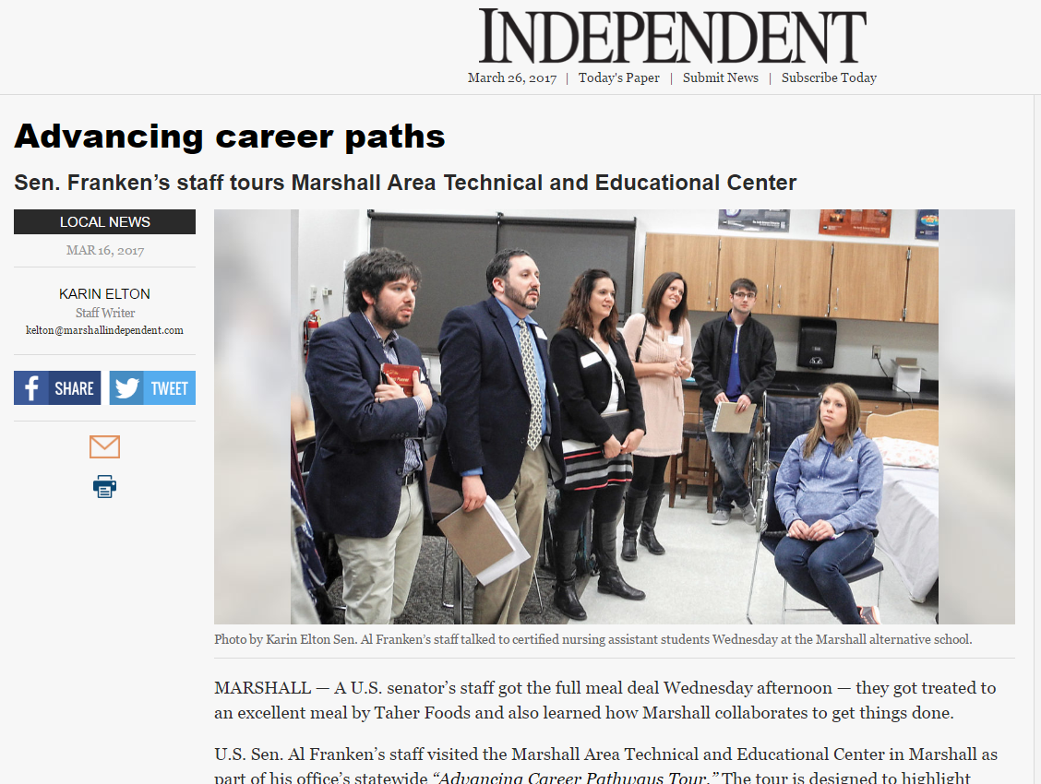
“Franken staffer Solomon said they have been to high schools all around the state and this is the first one they have come across to ‘incorporate ABE.’”

Slide 43
The pillars built together
By Marvin Guido
Dedicated to all the people that made a difference for me
I roar loudly toward the winds
Soundly, proudly say I win
For where I come from, I was lost,
But soon, I was laid down the way,
I soared undoubtedly into the sky,
And was set no boundaries,
I was free, finally.
I was given tools,
I used them all,
The resources were always there
It was for me to only care.
I carried my body, my soul and already prepared.
I am no more shy and walk in no shame
Change has come, and I am done with my past
Alas, it had always held me back. And in change
Chains are no more. The community made me strong
And in the community the pillars, you and I, is where we belong.
Hold on, thanks to you, there is many more to come.

Slide 44
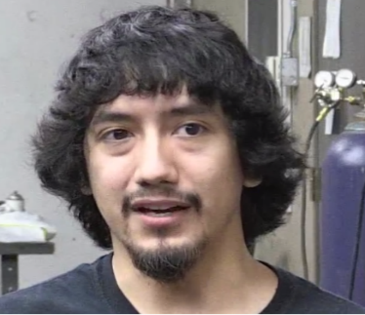
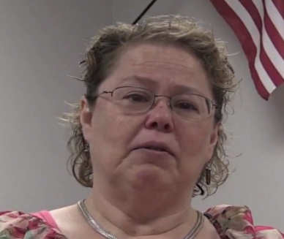
Innovation:
Gives Success
Co-Mingled Adult/
Youth Training
Student Testimonials
Johnathan Przymus
Welding- High School Student
Noe Verdin
Welding- Adult Student
Cynthia Dirckx
CNA – Adult Student
Full video can be viewed on the ABE website at http://www.southwestabe.org/

Slide 45
Innovation:
Gives Success
More ingredients jump into the mix!
Employers:
Heritage Pointe Senior Living – Marshall, MN
Prairie Home Hospice & Community Care – Marshall, MN
Minneota Manor – Minneota, MN
Prairie View Homecare Center – Tracy, MN
Colonial Manor – Balaton, MN
Avera – Marshall, MN
Boulder Creek and Stepping Stone Home Health Care – Marshall, MN

Slide 46
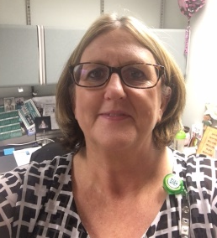
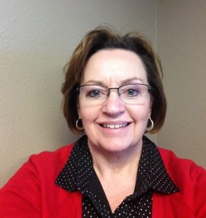
Innovation:
Gives Success
Innovation:
Gives Success
More ingredients jump into the mix!
Avera, Boulder Creek and Stepping Stone Home Health Care’s role in collaborating with ABE came out of a need for qualified staff to care for the seniors in our assisted living and memory care facilities.
Jackie Esping, Nursing Supervisor
Avera Marshall Morningside Heights Care Center
jackie.esping@avera.org
Tammy Gustafson, RN
Administrator
Boulder Creek Assisted Living-Memory Care
tammy@boulderestates.org

Slide 47
Innovation:
Gives Success
Goal: to employ qualified and educated certified nursing assistants with the added basic knowledge of dementia
Problem
Low unemployment rate in the area
Trained staff difficult to find
CNA training was very generic. Further training was needed to meet agency needs
A growing population of those with dementia needing specialized care
Solution
Students complete ABE-CNA course and feedback given to ABE on
aide’s performance and preparation for the job
A class on the overview of dementia added to class time
A virtual dementia tour becomes part of the curriculum
Employers participate in employer panels

Slide 48
Innovation:
Gives Success
Stepping Stone Home Care Center has offered the assistance of Registered Nurses to aide in the teaching process
Boulder Creek’s activity department has students assist with activities with dementia clients
Stepping Stone has given feedback on the new program, ‘Reading Skills for Health Care Workers’
Avera Marshall has set up the virtual dementia tour and has provided financial assistance for on-the-job training in its facility
Benefits :
Through this experience we have learned new ways of training staff, which gives the employees higher success rates on the job, greater job satisfaction and most importantly, belief in themselves that they can succeed toward their goals.

Slide 49
Innovation:
Gives Success
Project is a result of ABE and WorkForce joining resources to better serve the participant
Was developed with specific goals in mind to benefit the participants in their search for employment and independence

Slide 50
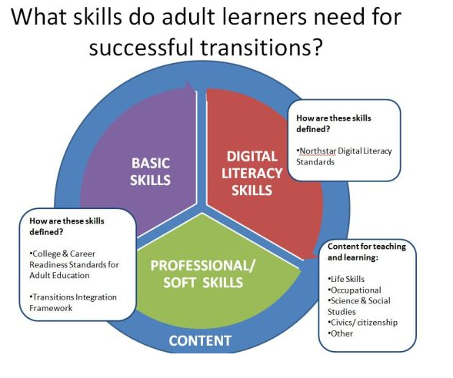
Innovation:
Gives Success
Minnesota ABE Content Standards

Slide 51
Innovation:
Gives Success
Goals:
Integrate participants into the community
Provide career exploration for low-functioning ESL participants allowing them to work on English and employment skills
Build resumes for participants who are re-entering the job market

Slide 52
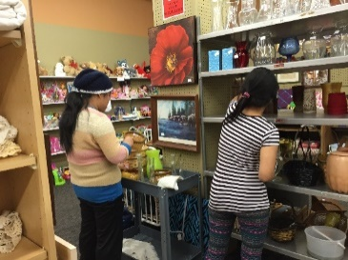
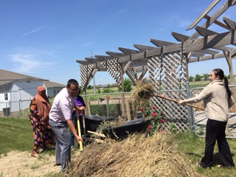
Innovation:
Gives Success
Participant Goals:
Soft job skills
Resume-building skills
Good employee and networking skills

Slide 53
Innovation:
Gives Success
Career Pathway
Curriculum Development
ATLAS-ABE Teaching & Learning Advancement System
Kristine Kelly
Adult Literacy Specialist & Project Lead for Curriculum Development
kristinerkelly@gmail.com

Slide 54
Innovation: Gives Success
Reading Skills for Healthcare Workers
A free online Career Pathway literacy curriculum based on CNA and general healthcare content
http://southwestabe.wix.com/rsforhealthcare

Slide 55
Innovation:
Gives Success
175 selections for intermediate-level readers between 5.5 and 8.5 grade levels
Selections focused on healthcare-related content written by licensed language arts/ESL teachers, most with pre-CNA teaching and course development experience
Focus on academic and content vocabulary with comprehension questions and writing prompts
Readability is measured by ATOS for College & Career Readiness alignment
All selections recorded in 3 speeds for fluency modeling
Reading Skills for
Healthcare Workers

Slide 56
Innovation: Gives Success
Mr. Howe’s Pneumonia
Recognizing Signs of Elder Abuse
Resident Rights in Nursing Homes
Samantha Learns about HIPAA
What is Dementia?
The Five Principles of Care
Breaking the Chain of Infection
Developing Cultural Competence
Taking Vital Signs
Performance Evaluation
Healthcare Settings
Planning for a Successful Job Search
End of Life Care for Mr. Stephens
Reading Skills for Healthcare Workers
Sample
Reading Selection Titles

Slide 57
Innovation: Gives Success
High-Utility Academic Vocabulary
adequate
condition
trigger
protocol
evaluate
factor
indicate
maintain
minimize
transition
decline
Content Vocabulary
airway obstruction
body mechanics
care plan
Fowler’s position
hygiene
intake
pathogens
respiration
scope of practice
HIPAA
health care directive
Reading Skills for Healthcare Workers
Sample Target Vocabulary

Slide 58
Innovation: Gives Success
Reading Skills for Healthcare Workers
Included with each reading selection:
Pre-reading questions
Pre-reading definitions of healthcare and high utility vocabulary
3 speeds of recorded text for learners to listen to for fluency development
Selection focused on healthcare-related content for engagement and motivation
Text dependent questions for understanding.
2 writing options
1 text dependent
1 more open ended

Slide 59
Innovation: Gives Success
Currently laying the groundwork for…
Reading Skills for Manufacturers

Slide 60
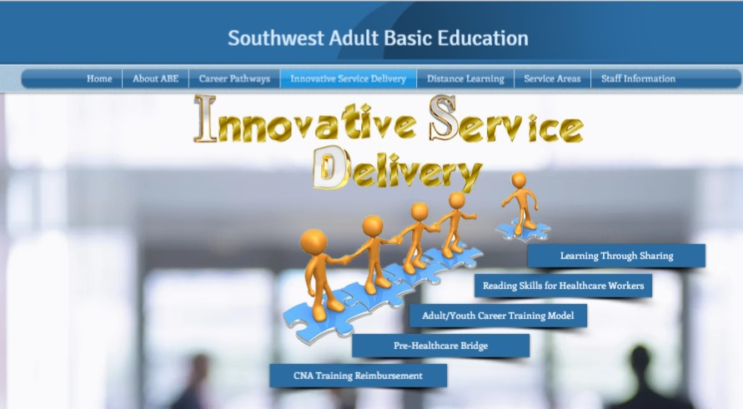
To get more information about our successes…….
1.
www.southwestabe.org
2.
3.
Pat Thomas – Director
SW ABE Marshall Region
pthomas@starpoint.net

Slide 61
When faced with possible hardships, focusing on a positive attitude and being open to new ways of collaboration becomes even more critical!
When the doors are closed, windows are opened.
Your attitude will determine if you can see the open windows.

Slide 62
Voila!
A Recipe for Success
In summary I am here to confidently state that collaboration (real collaboration) and innovation create success for your students.
Wisdom from “Been around the block”:
Focus on your client and his/her success
Be aware of others who share that client’s success as a focus from other agencies
Be open to new ideas
Be willing to seize opportunities as they present themselves
I can assure you our students are receiving better services due to our collaborations – not duplicating services! And that
is what WIOA is all about.
The recipe is always reinventing itself.
New Ingredients =New Successes

