Slide 1
Marshall Area Global Relief

Slide 2
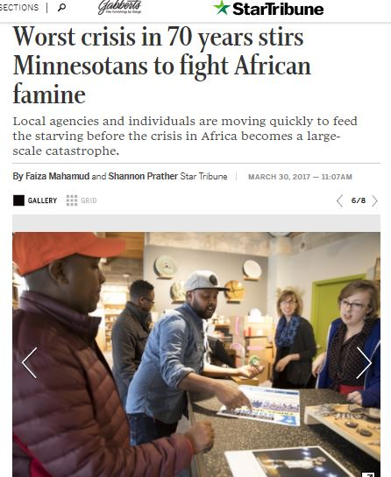
What brought about this effort?
Somali neighbors in Marshall
Bonded by humanity
Discussions lead to group formation
Notes:
An article on the crisis appeared on March 30th and caught the attention of a few Marshall residents due to some of our Somali neighbors who have family back in Somalia. The articles states that UN lists this as the worst drought in 70 years with 20 Million families affected and 70% of livestock dead.
While we are not directly affected by the crisis, we are bonded by humanity and the struggles we all face. Many of us could not imagine what this situation might be like.
Discussion started happening and slowly a group of concerned citizens got bigger and the group was formed.

Slide 3
Marshall Area Global Relief
Mission is to unify Marshall and surrounding community members of all colors, creeds and faiths to join in giving so that our neighbors, here and abroad, can better meet basic human needs.
Purpose is to help Marshall area community members understand and support our Somali neighbors (and their families abroad) by contributing to African famine relief efforts.
Goal is $15,000
Notes:
In a few short meetings, the group developed a mission, purpose and goal. The mission is to [read]. The purpose is [read]. Our goal is to raise $15000 by July 22, 2017.
It is not a designated 501c3 as that would have taken too much time; time that the people in the region do not have. To help quickly, the group sought out another organization to take donations.

Slide 4
Who is ARAHA?
Mission: ARAHA strives to alleviate human suffering and build self-reliant communities, by providing humanitarian aid and empowering individuals in the Horn of Africa and here at home.
Charity Ratings
Notes:
What we liked about ARAHA and their mission is that they strive to build self-reliant, rather than dependent, communities.
Since its formation in 2000, the organization has;
Built over 200 wells
With various projects, have served over 2 million people
Distributed almost 700,000 food baskets
Built a school for nursing built, developed programs to help families learn to generate their own income and provided other education support
Have provided significant medical support to the area
Helped over 10,000 orphans and;
Have completed several solar projects
They have some of the top charity ratings; A Guidestar Gold rating for it’s transparency, A 4 star rating (its highest) from Charity Navigator. NOTE TO PRESENTER: They could not be found on the Charities Review Council.

Slide 5
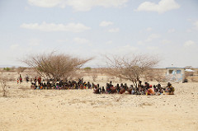
What is the crisis?
Notes:
May 17 article on UN website says 30 million people in 4 countries including Somalia, South Sudan, Nigeria and Yemen are unsure of where their next meal will come from. (http://www.un.org/apps/news/story.asp?NewsID=56777#.WTmug-vyvIU0 )
More than ½ million people in Somalia are in need of humanitarian assistance with 275,000 malnourished children at risk of starvation, according to a UN article from May 11 (http://www.un.org/apps/news/story.asp?NewsID=56729#.WTmvr-vyvIU).

Slide 6
Who is involved and why?
Notes:
What does the Somalian community in Marshall do for the cause? A. Send funds back to their families b. be a part of this group and help with activities such as video, contacts, etc. SMSU students walking around?

Slide 7
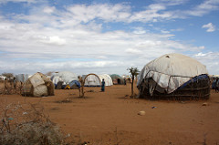
Community Member: Farah
Notes:
So you can understand how our area community is directly involved, I am highlighting a couple of members. First, Farah was too shy for a picture but this is what it looked like for his mother before she came to Marshall. Farah’s mother moved to refugee camp when he was young and eventually to Marshall. She finally obtained a visa for him to join her in 2014 when he was 15 years old and he joined her here. His father and aunt who ended up raising him are still in Somalia. Because he sends funds back regularly, they have food and water, but many friends back there do not.

Slide 8
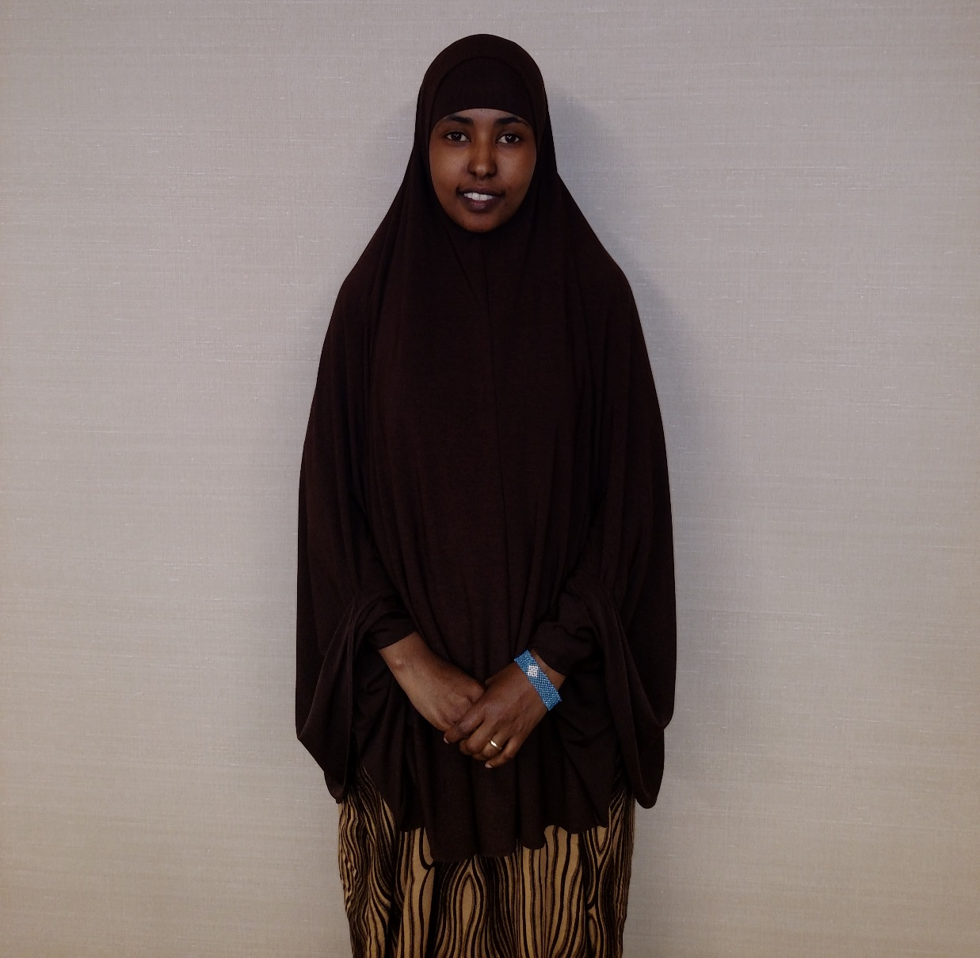
Community Member: Fartun
Somali Parent Student Connector
Marshall Public Schools
Notes:
Fartun is Somali Parent Student Connector at Marshall Public Schools and has been one of the most active members of the group. She lived in Somalia until age 12 and then came to Minnesota from refugee camp in Kenya. Except an older sister, parents and siblings are still in Somalia. She wants others to help, quote “because of humanity and caring for people. These people have nothing to eat. What if this was your child?”

Slide 9
Why am I personally involved?
Notes:
Insert a picture of yourself – then talk about what inspired you to get involved in the group. Maybe even mention what you’ve done both in work and personal financial support for the effort. For example, some people make the contacts, send emails etc. We’ve had logos and brochures created, stories tapped etc. The more you let people know how this affects you and what you’ve already done to help, they are more likely to give too.

Slide 10
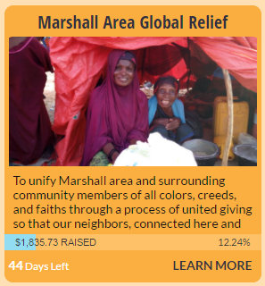
What has been done so far?
Knights of Columbus in Minneota - $500
Parkside & Westside teachers - $425
First Lutheran Chancel Choir - $1.025
Note: Some not yet showing online
Notes:
The ARAHA website will update the giving as they receive funds. Because some funds go through Bremer Bank it takes a few days for this to update but it does happen pretty quickly. With a few simple requests for giving, chancel choir members at First Lutheran gave over $1000 and teachers at the elementary schools gave over $400. One of the group’s participants presented to Knights of Columbus in Minneota which resulted in a $500 gift for the effort.

Slide 11
3 ways to donate
Online – http://araha.org/projects/marshall-area-global-relief - select one of the following;
Water wells
Emergency food baskets
Solar-powered lamps
Undesignated (wherever needed)
Give to a local congregation/mosque/organization that is helping and give your cash or check to them and they will take to Bremer Bank for deposit and transfer. Groups will be recognized online.
Drop donations off at Bremer Bank directly
Checks should be made out to Marshall Area Global Relief with ARAHA in the subject line.

Slide 12
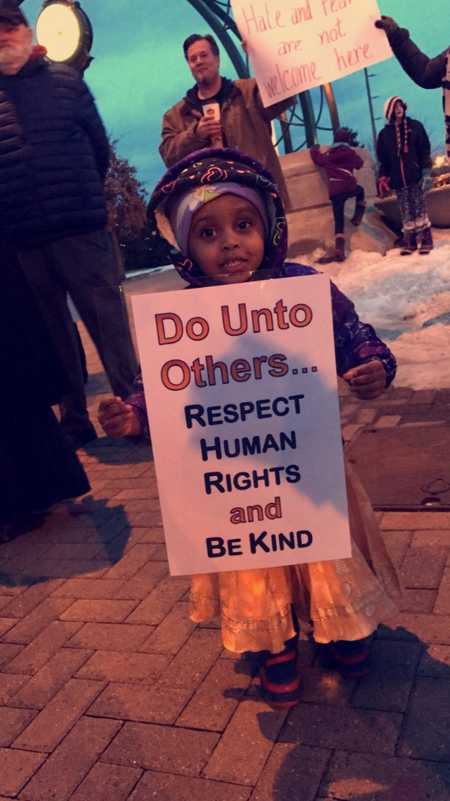
Franklin D. Roosevelt
“Human kindness has never weakened the stamina or softened the fiber of a free people. A nation does not have to be cruel to be tough.“
Notes:
FOR SPEAKER: If you don’t like the current quote, here are a few others:
"Love and kindness are never wasted. They always make a difference. They bless the one who receives them, and they bless you, the giver." -Barbara de Angelis
"Remember there's no such thing as a small act of kindness. Every act creates a ripple with no logical end." -Scott Adams
"A single act of kindness throws out roots in all directions, and the roots spring up and make new trees." -Amelia Earhart

Slide 13
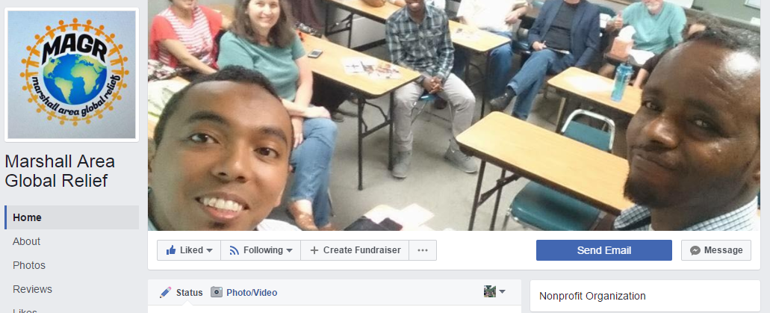
Contact
marshallagr@gmail.com
OR Search for Marshall Area Global Relief on Facebook and send a message

