Slide 1
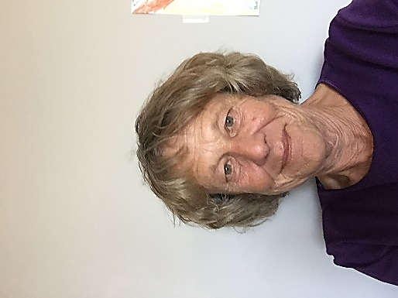
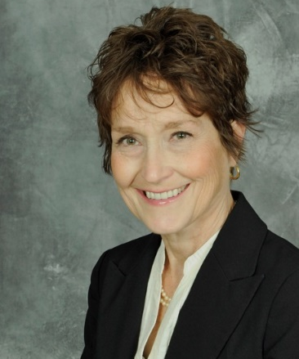
Collaboration + Innovation = Success
Welcome and Introduction
Pat Thomas, Director
Southwest Adult Basic Education (SW ABE)
Pat has been an ABE Director for 17 years in southwestern Minnesota. She began the FastTRAC journey with its inception and continues working to make it a more effective tool for ABE learners.
pthomas @starpoint.net
Host
Lois Schmidt, Director of Development
Project Turnabout Centers for Addiction Recovery
Lois has a background of working with nonprofit and community organizations, including many of them participating in this presentation. Throughout her career, her interest has been in connecting rural groups to resources and to each other.
lschmidt@projectturnabout.org
Facilitator

Slide 2
Wisdom from Our Host
Presentation will showcase Partnerships and Collaborations in our region
WIOA – Joining forces and resources
Collaborations & Partnerships are “Messy and Challenging” but….
Partners are Presenters
Rural Region is a strength to our Career Pathway Trainings
Journey began in early 2000’s – Today is Business as Usual
A Career Pathway is a series of structured and connected education programs and support services that enable students, often while they are working, to advance over time to better jobs and higher levels of education and training.

Slide 3
If you are looking for DETAILS…
ABE Homepage: southwestabe.org
Innovative
Service
Delivery

Slide 4
Innovative Service Delivery

Slide 5
The Path Our Journey Will Take
Partnership Foundation
Background & History
Collaboration
Extended
Partnerships
Our
Future

Slide 6
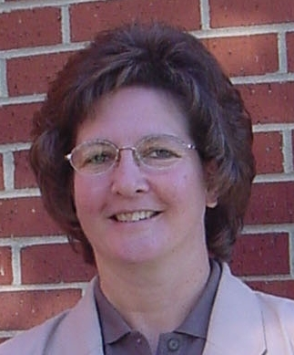
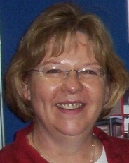
Partnership Foundation
Background & History
Dawn Regnier
Carol Dombek

Slide 7
Collaboration+Innovation =
Success
MN House of Representatives
Minnesota
Judicial
Branch

Slide 8
The student’s success is our focus—whether adult or youth.
“Wherever a student is in life’s journey when he or she enters our program,
that individual will move forward to find success.”

Slide 9
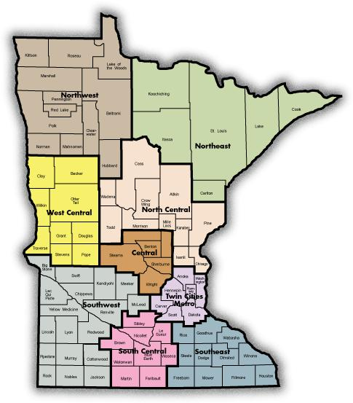
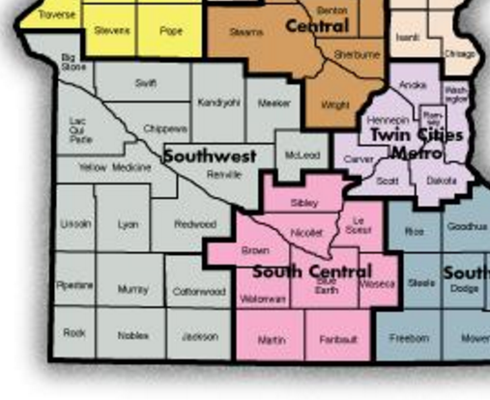
Our Neck of the Woods
Southwest
Minnesota

Slide 10
What SW Minnesota has to offer
22 Rural Counties (Approximately 25% of the state)
Population: 163,410 State Population: 5,344,861
Two Regional Centers
Marshall Population 13,000 Worthington Population 12,000
Primary Industry Sectors
Agriculture Healthcare
Manufacturing Energy
Transportation Finance/Banking
Government Food Processing

Slide 11
Regional Facts Influencing Partnerships & Collaborations
Population decline & low population density
Influx of international immigrants/refugees requiring specialized services
Very low unemployment rates (2.9%)
Shortage of skilled workforce
Large geographic area/Distance between communities
Lack of public transportation
Limited child care providers

Slide 12
Collaboration:
What it looks like to Us
Multiple organizations and systems working together
Focused on successful participant outcomes
Each organization adapting to best serve participants
Operating with a “Work in Progress” protocol
Cooperating to secure financial resources

Slide 13
Collaboration:
Beginning the Process
Connect with partners willing to work
together
Ensure all partners have a clear
understanding that the success of the
participant is the #1 priority

Slide 14
Collaboration:
Sustaining the Process
Focus on the participant being served
Engage partner’s resources: talents and purpose
Willing to experiment and explore new ideas
Ability to manage conflict effectively
Ability to adapt and change quickly – Be flexible
Maintain a “Problem Solving Mentality”

Slide 15
Collaboration:
Funding Program Delivery
Braided Funding
Braided Funding: The process of combining funds from different sources to support an individualized set of services so that expenditures from each source can be tracked and applied to specific individuals eligible for that funding.
Collaborating Organizations funding sources: Pell Grants, Community Grants, Federal & State program funding, Local School District, State Re-imbursement legislation, Employer contributions/reimbursement.
Captured From 2003 – 2016 $6,299,065

Slide 16
Partnership
Foundation
Collaboration

Slide 17
Pat Thomas
Director
pthomas@starpoint.net
Partners in the Collaboration
SW ABE – Marshall Region

Slide 18
Partners in the Collaboration
Southwest Regional Adult Basic Education (ABE)
Marshall Granite Falls Worthington/Jackson
2 Regional Directors 55 Instructors--Majority are part-time
ABE’s Role
Primary point of contact for collaboration participants
Assessment: reading, math, computer skills
Participant literacy development focus
Participant recruitment for training programs

Slide 19
Partners in the Collaboration
ABE’s Value Gained:
More frequent and a wider variety of trainings
Provides an entry level position opportunity for Immigrant/ESL students
Co-Mingling of youth and adults creates a “Realistic Workplace Setting” allowing both parties to gain appreciation and respect for each other’s skills.

Slide 20
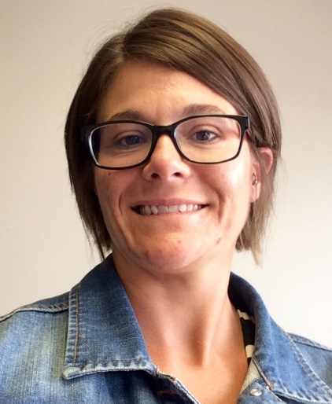
Partners in the Collaboration
Carol Dombek,
Planner/Special Projects
Coordinator
cdombek@swmnpic.org
Eriann Faris,
Youth Program Manager
efaris@swmnpic.org
Southwest WorkForce Center
Southwest Private Industry Council (PIC)

Slide 21
Partners in the Collaboration
Southwest WorkForce Center
(also known as American Job Center, One-Stop Center)
Regional Office Locations: Montevideo Marshall Worthington
WorkForce Center Partners
Southwest MN Private Industry Council
-WIOA Title 1 (workforce development)
Job Service
-WIOA Title III (Wagner-Peyser – labor exchange, unemployment insurance, business services)
Department of Rehabilitation Services/State Services for the Blind
-WIOA Title IV
Veterans Services

Slide 22
Partners in the Collaboration
WorkForce / SW PIC Role
Identify & create awareness in demand jobs
Career exploration and career planning
Employability skills/retention/transition skills
Work-based learning (work experience, OJT)
Job placement
Case management and support services
Support Career Pathway Training

Slide 23
Partners in the Collaboration
SW PIC Role
Convener of Career Pathway Partnership
Fiscal management & reporting for grant funds
Outreach and recruitment
Participant eligibility determination
Pathway Navigator Services
Participant support, identify need for services
Career assessment, exploration, plan development
Coordinate services between students and partners

Slide 24
Partners in the Collaboration
WorkForce / SW PIC Value Gained
Leverage of Resources
Co-enrollment (A proven means for OSY recruitment for WIOA purposes)
Non-duplication of services
Increased value-added services (i.e. employer panels, business tours, campus tours, dementia tours, etc.)
More comprehensive programming available to customers

Slide 25
Partners in the Collaboration
Dawn Regnier
Director of Customized Training
dawn.regnier@mnwest.edu
Minnesota West Community & Technical College

Slide 26
Partners in the Collaboration
Minnesota West Community and Technical College
5 Campus Locations - 2 Education sites
Over 70 major degree programs
Customized training/continuing education
Only 2-year higher education institution in the region
Collaborate with Southwest Minnesota State University – the only 4-year university in the region

Slide 27
Partners in the Collaboration
MN West Role
Participant recruitment
Identify workforce training needs for high-demand occupations
Identify and develop skills training curriculum
Provided technical skills training
Award college credits – Non-credit certificate & industry-recognized credentials

Slide 28
Partners in the Collaboration
MN West Value Gained
Enhanced student participant comprehension
Increased student completion rates
Increased student job placement
Enhanced relationships with employers
Strengthened awareness for programs
Sustainable business model
Expanded financial resource acquisition

Slide 29
Extended Partnerships

Slide 30
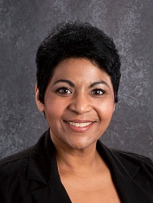
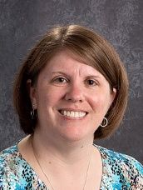
Extended Partnerships
Michelle Noriega, Assistant Principal
michelle.noriega@marshall.k12.mn.us
Leanna Ginocchio
Administrative Assistant
leanna.ginocchio@marshall.k12.mn.us
Marshall Area Technical and Educational Center (MATEC)

Slide 31
Extended Partnerships
MATEC Role
Provide customized learning experience
Offer flexible learning environment for students grades 9-12 and out-of-school youth up to age 21
Innovative dual high school & college credit programs
Offer college technical courses for Career Pathway Training: Certified Nurse Assistant & Welding
Successfully initiated Co-Mingled Adult/Youth Program Model

Slide 32
Extended Partnerships
How Duties Changed When Adults & Youth
Co-Mingled :
Created a central location for dissemination of information (i.e. billing, contracts, background checks, ordering supplies, scheduling, etc.)

Slide 33
Co-Mingled Adult/Youth Program Model
How The Model Began
Created out of need
Cost of class delivery same regardless of class size
Challenge to recruit adult participants due to low unemployment and other factors
Maximize efficient use of resources
Based on governor’s World’s Best Workforce Mandate
Established grass roots program “Marshall Adult/Youth Career Training”
Re-vitalize career technical training
Integrated setting for high school – college – adult participants

Slide 34
Co-Mingled Adult/Youth Program Model
Training delivery addressed education & workplace employment needs
Addressed academic and personal barriers to successful participation/completion
Fostered Post Secondary Education Options for youth participants to earn college credits in high school
Managed requirements for blending adult & youth participants
Background Checks
The Model is Forever A Work In Progress
We continue to encounter “BUMPS” and “Collaborate” to find Solutions to Smooth the Bumps.

Slide 35
Co-Mingled Adult/Youth Program Model
Collaboration Value Gained from Co-Mingling Adults and Youth
Learning environment replicates work environment with multi-generations
Adults learn technology & classroom skills from the youth
Adults and youth gain mutual respect.
Improved literacy rates for comprehension, math and digital literacy
Strengthens participants’ self-confidence; builds self-esteem and career mindset
Achievement of high school and college credits
Breaks the cycle of poverty
Multiple funding sources & classroom/administrative support
Multiple sources of student recruitment to fill class requirements

Slide 36
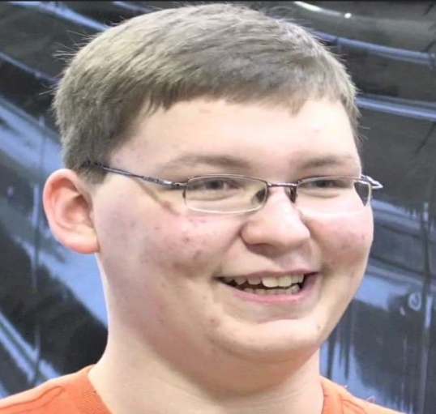
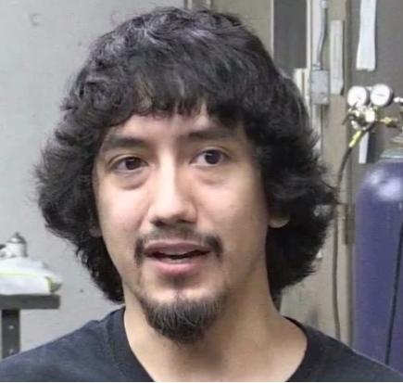
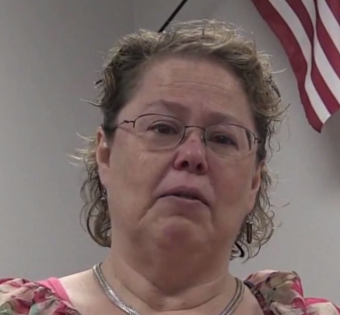
Now Showing
Student Testimonials
Johnathan Przymus
Welding- High School Student
Noe Verdin
Welding- Adult Student
Cynthia Dirckx
CNA – Adult Student

Slide 37
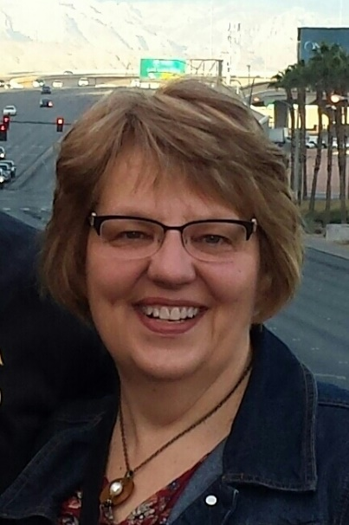
Extended Partnerships
Dawn Jennings, RN
dawn.jennings@swmhhs.com
Ann Abraham, RN, BSN, PHN
ann.abraham@swmhhs.com
Southwest Health and Human Services,
Public Health

Slide 38
Public Health/ SW Health and Human Services
Extended Partnerships
Role:
Administer & read TB skin test
Review immunization records
(This is done for CNA students to ensure they are ready to start their clinicals. These services are offered at a low cost.)
Benefits:
Great way to get student connected with services offered at Public Health.
Remove cost barriers to allow more individuals to enter the healthcare field
Public Health is committed to the well-being and safety of our communities.

Slide 39
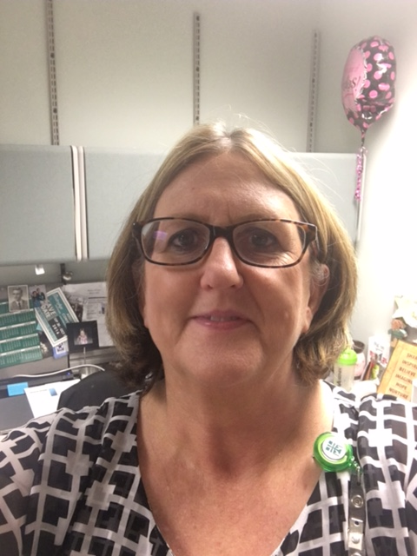
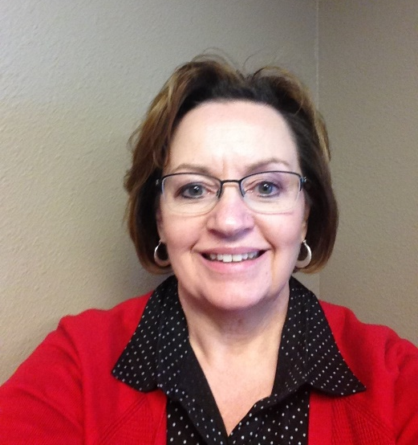
Extended Partnerships
Tammy Gustafson, RN
Administrator
Boulder Creek Assisted Living-Memory Care
Employers
tammy@boulderestates.org
Jackie Esping, Nursing Supervisor
Avera Marshall Morningside Heights Care Center
jackie.esping@avera.org

Slide 40
Extended Partnerships
Avera, Boulder Creek and Stepping Stone Home Health Care’s role in collaborating with ABE came out of a need for qualified staff to care for the seniors in our assisted living and memory care facilities.
Goal To employ qualified and educated certified nursing assistants with the added basic knowledge of dementia
Problem
Low unemployment rate in the area
Trained staff difficult to find
CNA training was very generic. Further training was needed to meet
agency needs
A growing population of those with dementia needing specialized care
Solution
Students complete ABE- CNA course and feedback given to ABE on
aide’s performance and preparation for the job
A class on the overview of dementia added to class time
A virtual dementia tour becomes part of the curriculum
Employers participate in employer panels

Slide 41
Extended Partnerships
Putting some skin in the game:
Stepping Stone Home Health Care has offered the assistance of Registered Nurses to aide in the teaching process
Boulder Creek’s Activity Department has students assist with activities with dementia clients
Stepping Stone has given feedback on the new program, ‘Reading Skills for Health Care Workers’
Avera Marshall has set up the virtual dementia tour
Benefits:
Through this experience we have learned new ways of training staff, which gives the employees higher success rates on the job, greater job satisfaction and most importantly, belief in themselves that they can succeed toward their goals.

Slide 42
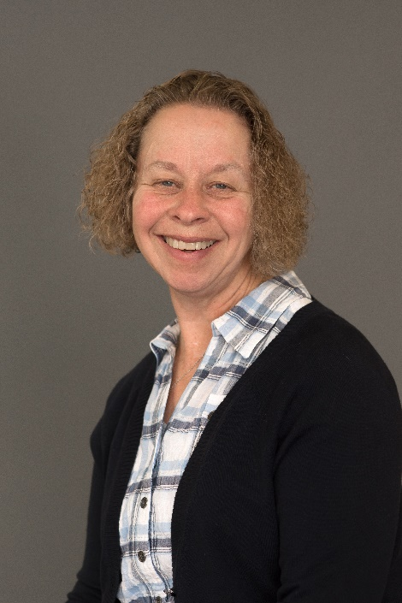
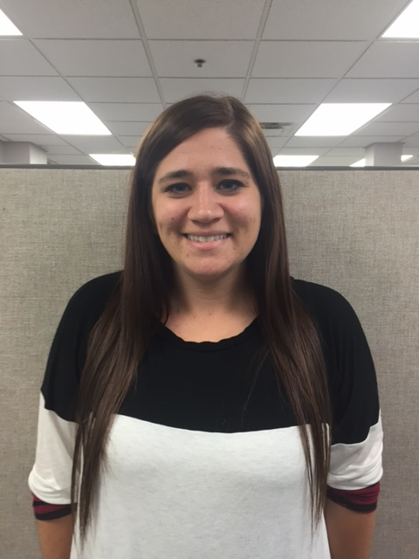
Extended Partnerships
Paulette Hanson, Project Coordinator
turtle0@live.com
Ashley Wirtz, Case Manager
awirtz@swmnpic.org
SW ABE – Marshall Region
WorkForce

Slide 43
Extended Partnerships
Who We Are:
Project is a result of ABE and WorkForce joining resources to better serve the participant
Was developed with specific goals in mind to benefit the participant in their search for employment and independence

Slide 44
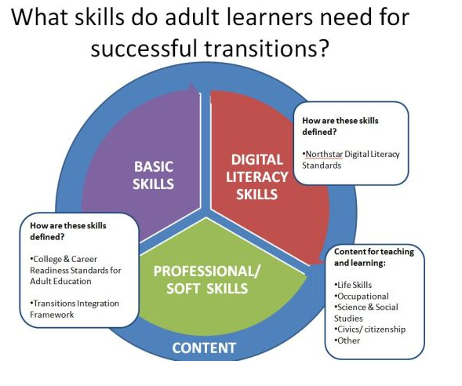
Extended Partnerships

Slide 45
Extended Partnerships
Goals:
Integrate participants into the community
Provide career exploration for low-functioning ESL participants allowing them to work on English and employment skills
Build resumes for participants who are re-entering the job market.

Slide 46
Extended Partnerships
Activities and Experiences:
Learners work with Advance Opportunities, an agency which works with people who have developmental disabilities.
Heart to Heart allowed Learning thru Sharing participants to help prepare food for distribution.
Learning thru Sharing participants went to the Adult Community Center and made sambusa and other dishes for the senior citizens.
Participants have spent time during the summer working at the Western Community Action community garden.

Slide 47
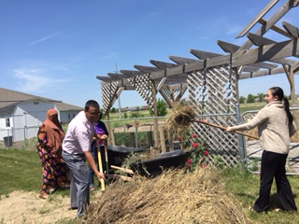
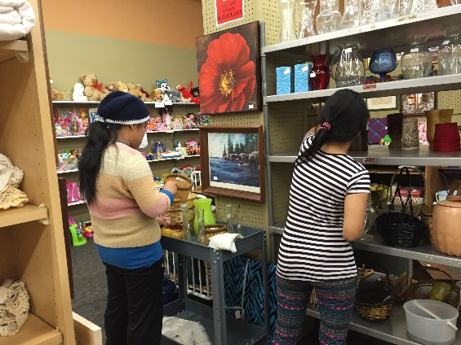
Extended Partnerships
Participants Gain:
Soft job skills
Resume-building skills
Good employee and networking skills

Slide 48
Extended Partnerships
Pat Thomas, Director
pthomas @starpoint.net
SW ABE – Marshall Region

Slide 49
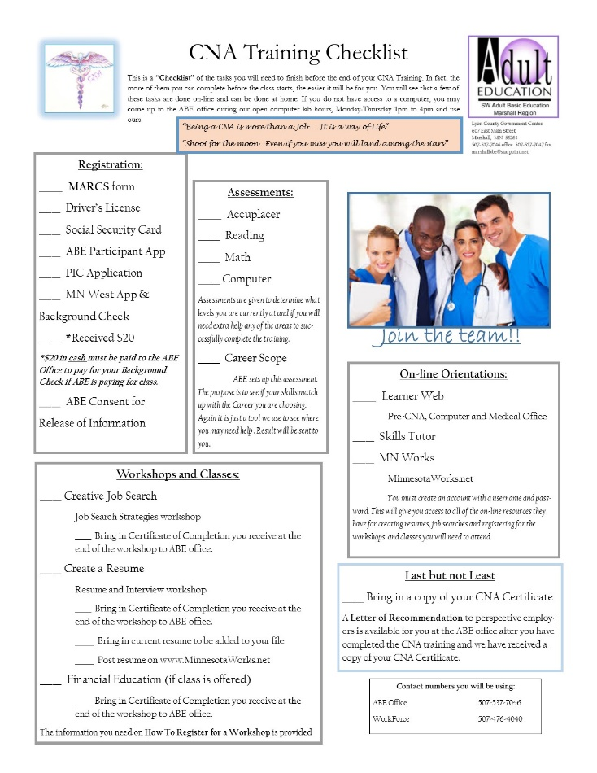
Extended Partnerships
Pre Healthcare Bridge
The Pre-Healthcare Bridge is the first step to starting CNA training. It takes the student through registration, assessment and preparation for the training, the goal being to ensure the success in the training.
The CNA Bridge Packet gives participants all the forms they will need to complete, evaluation testing they will need to take, and the online programs they will need to get them ready for the training.
Students receive the packet when they come into the ABE office to start their journey to becoming a CNA. The Checklist allows a student and ABE to track the student’s progress.

Slide 50
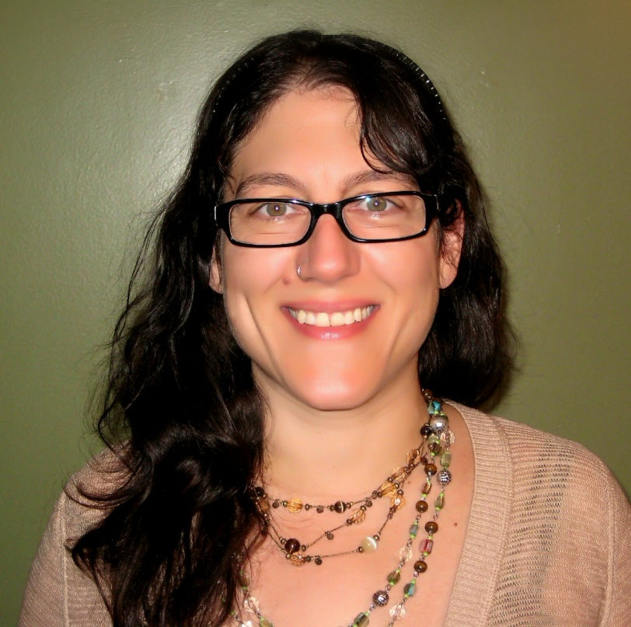
Extended Partnerships
Kristine Kelly
Adult Literacy Specialist & Project Lead for Curriculum Development
kristinerkelly@gmail.com
ATLAS-ABE Teaching & Learning Advancement System

Slide 51
Extended Partnerships
Reading Skills for
Healthcare Workers
A free online Career Pathway literacy curriculum based on CNA and general healthcare content
http://southwestabe.wix.com/rsforhealthcare

Slide 52
Extended Partnerships
Reading Skills for
Healthcare Workers
175 selections for intermediate-level readers between 5.5 and 8.5 grade levels
Selections focused on healthcare-related content written by licensed language arts/ESL teachers, most with pre-CNA teaching and course development experience
Focus on academic and content vocabulary
Readability is measured by ATOS for College & Career Readiness alignment
All selections recorded in 3 speeds for fluency modeling

Slide 53
Extended Partnerships
Reading Skills for Healthcare Workers
Sample Reading Selection Titles
Mr. Howe’s Pneumonia
Recognizing Signs of Elder Abuse
Resident Rights in Nursing Homes
Samantha Learns about HIPAA
What is Dementia?
The Five Principles of Care
Breaking the Chain of Infection
Developing Cultural Competence
Taking Vital Signs
Performance Evaluation
Healthcare Settings
Planning for a Successful Job Search

Slide 54
Extended Partnerships
Reading Skills for Healthcare Workers
Sample Target Vocabulary
Content Vocabulary
airway obstruction
body mechanics
care plan
Fowler’s position
hygiene
intake
pathogens
respiration
scope of practice
High-Utility Academic Vocabulary
adequate
condition
determine
evaluate
factor
indicate
maintain
minimize
transition

Slide 55
Extended Partnerships
Reading Skills for Healthcare Workers
Included with each reading selection:
Pre-reading questions
Pre-reading definitions of healthcare and high utility vocabulary
3 speeds of recorded text for learners to listen to for fluency development
Selection focused on healthcare-related content for engagement and motivation
Text dependent questions for understanding.
2 writing options:
1 text dependent
1 more open ended

Slide 56
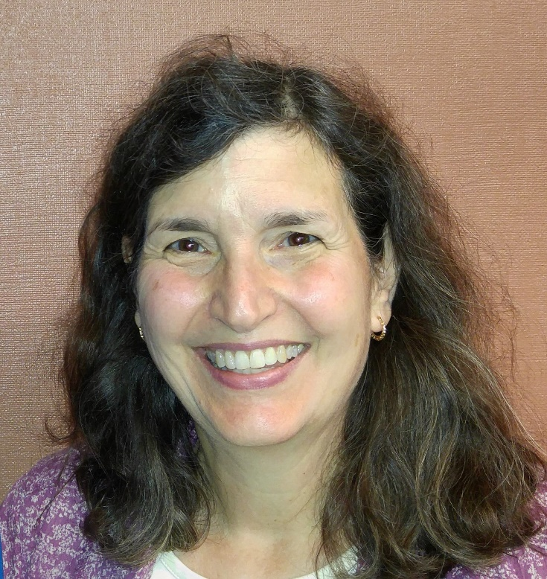
Candace Thomas
Executive Director
cthomas.literacy.swmn@gmail.com
Extended Partnerships
Literacy Volunteers of Southwest Minnesota

Slide 57
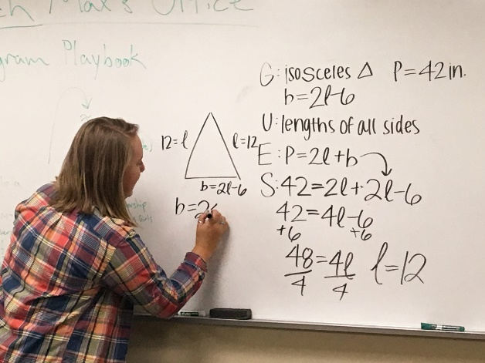
Extended Partnerships
Literacy Volunteers
How @LiteracySWMN Supports ABE and WorkForce
Refer participants to ABE and WorkForce
Train ABE classroom tutors
Provides tutors to ABE participants who cannot regularly attend ABE classes due to work schedules or other barriers
Provides specialized tutoring services as needed by individual ABE participants

Slide 58
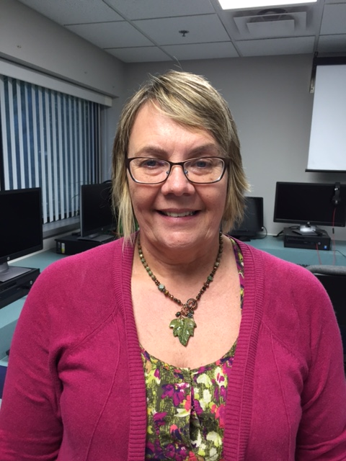
Extended Partnerships
Darcy Kleven
Program Manager
dkleven@mrved.net
SW ABE –
Granite Falls Region

Slide 59
Extended Partnerships
Creating Daycare Career Training

Slide 60
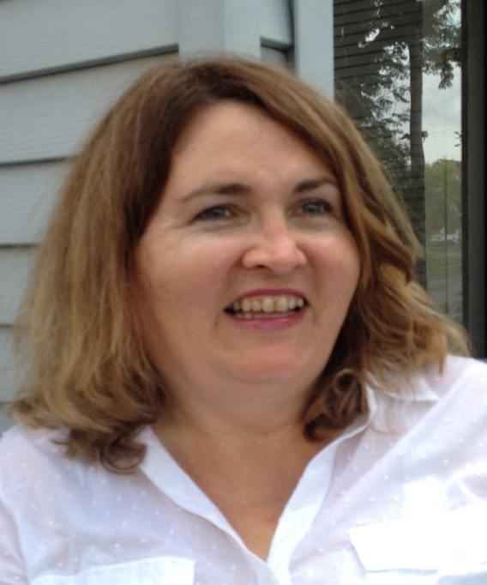
Karin Elton, Reporter
Extended Partnerships
kelton@marshallindependent.com
Independent
Southwestern Minnesota’s Daily Newspaper

Slide 61
Extended Partnerships
Relationship with Local News
Stories in the newspaper inform readers of the results of collaborations
Benefits:
Readers become aware of services and benefits to the community offered by the agencies involved in the collaboration
Readers gain knowledge of what their “tax dollars” are paying for
Readers may be inspired by the stories and might decide to use the services to improve their lives and their families' lives.

Slide 62
Extended Partnerships
Michelle Noriega, Assistant Principal
michelle.noriega@marshall.k12.mn.us
Marshall Area Technical and Educational Center (MATEC)

Slide 63
Extended Partnerships
Immigrants/Refugees & School Connections
Students in high school classes like social studies hear stories about refugees fleeing their native countries.
Benefits
Breaking down of barriers and stereotypes
Learning about & gaining a greater understanding of people who may look different

Slide 64
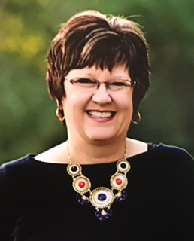
Extended Partnerships
Karen Bierman
Lyon County Court Administrator
karen.bierman@courts.state.mn.us
Lyon County Court Administrator
Minnesota
Judicial
Branch

Slide 65
Extended Partnerships
Relationship with the Court System
The greatest opportunity people who have chosen to make the United States their home have is to become legalized citizens.
Swearing in ceremony of new citizens done collaboratively
Benefits
When immigrants become citizens they
gain a vested interest in contributing to the community
are motivated to continue their education
become role models
Minnesota
Judicial
Branch

Slide 66
Our Future

Slide 67
Future
Project
Dawn Wambeke
Executive Director
dawn.wambeke@advanceopp.org
Advance Opportunities

Slide 68
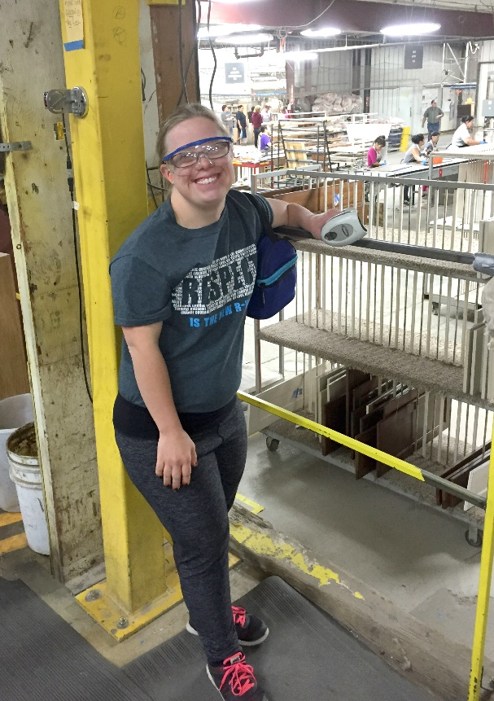
Disability Employment Initiative:
Career Pathway Manufacturing Training
Advance Opportunities is a nonprofit that provides employment and training for adults with developmental and intellectual disabilities.
Leverages the expertise of all partners to create a unique, customized fast-track training program leading to competitive jobs in the high-demand manufacturing industry
Partners: SW MN PIC, ABE, MN West Community and Technical College, Mid Continent Cabinetries
Benefits:
Has successfully placed 30 persons with disabilities into competitive employment at Mid Continent Cabinetries
Strengthens the existing relationship with Mid Continent by providing pre-job placement training and new career laddering opportunities
Integrates rural SW and SC Minnesota community and significantly expands the number of persons who will obtain gainful employment in the manufacturing industry

Slide 69
Sustainability and the Future
Representative Joe Schomacker
rep.joe.schomacker@house.mn
Minnesota House of Representatives
MN House of Representatives

Slide 70
MN Legislature Providing Sustainability
CNA Training Reimbursement Legislation
Legislation has been passed that states:
After the CNA is employed successfully for 90 days at a long-term nursing facility, the ABE program that provided funding for the CNA’s training can be reimbursed for the following costs:
Tuition
Competency tests
Books
And up to 30% more for the additional services provided to the student from the nursing home
**Check out the Innovative Service Delivery page on the ABE website for more information

Slide 71
Wrapping it Up
Question & Answer Time

