Slide 1
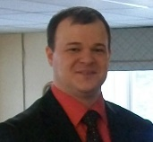
Working With Adult Training Programs Specifically ABE (Adult Basic Education)
Pat Thomas
SW ABE Director
pthomas@starpoint.net
Jason W. Swanson
Tealwood Regional Operations Director
Jason.swanson@twsl.com

Slide 2
Topics of Discussion
For the purpose of this presentation we will focus on our Career Pathway Training in Health Care – Certified Nursing Assistant Class
How to partner with area agencies to grow employees

Slide 3
Statewide Employee Vacancy Rates Increases in 2016 for Nurses and Home Care Aides

Slide 4
Reasons for Vacant Positions Competition and lack of applicants are biggest concerns

Slide 5
Vacant Direct Care Positions in Nursing Homes Now Total Over 2,800 Statewide
Source: Long Term Care Imperative Legislative Surveys

Slide 6
Average Nursing Home has 7.8 Vacant Direct Care FTE, Including more than five Nursing Assistant FTE
Source: Long Term Care Imperative Legislative Surveys

Slide 7
Historically
Place an ad in the newspaper
Recruit from High Schools
Friends would refer candidates

Slide 8
What do you Think Bob?

Slide 9
Ready to take the Plunge?

Slide 10
Providers
We need to find alternative sources:
Social Media
SCRUB Camp
High School – College Students
Adult Basic Education/Workforce/Community College partnership (and if you are willing to look way outside the BOX add your Public High School!)

Slide 11
The Importance of Immigration
In the face of increasingly tight labor markets, a growing scarcity of workers is now recognized as one of Minnesota’s most significant barriers to sustained economic growth.
In a tight labor market, immigrants are a vital source of talent for Minnesota employers. Foreign-born workers now account for 10 percent of the state’s labor pool.
IMMIGRANTS AND THE ECONOMY
minnesota economic TRENDS december 2017 https://mn.gov/deed/assets/immigrants%20and%20economy_tcm1045-323029.pdf

Slide 12
What is ABE
The mission of Adult Basic Education in Minnesota is to provide adults with educational opportunities to acquire and improve their literacy skills necessary to be self-sufficient and to participate effectively as productive workers, family members, and citizens.

Slide 13
ABE
Along with supporting the above mission statement, Southwest ABE prioritizes the goal of assisting students in gaining skills to obtain meaningful employment. Southwest ABE sees the priority of employment training as the most effective means of assisting our students in all areas of their lives.

Slide 14
WorkForce/Private Industry Council
SW ABE Marshall Region
Marshall Public School District
OUR FOCUS
MN West Community and Technical College
Community Employers

Slide 15
SW Adult Basic Education
ABE’s Role
Point of contact for collaboration participants
Assessment: reading, math, computer skills
Participant literacy development focus
Participant recruitment for training programs
Prepare students to take CNA training through an on-line more independent format
ABE’s Value Gained:
More frequent and a wider variety of trainings
Provides an entry-level position opportunity for immigrant/ESL students/underemployed or unemployed students.
SW Adult Basic Education
Marshall Granite Falls Worthington/Jackson
3 Regional Directors (to be reduced to 2 in near future)
55 Instructors—Majority are part-time

Slide 16
SW WorkForce/Private Industry Council
Brings their clients to the trainings as well as a Skills Navigator.
The Skills Navigator
Handles participant intake, eligibility determination, file maintenance, career plan identification; provides tailored support services; helps participants navigate the various resources available to help overcome barriers to success; and serves as Work Experience/On the Job Training (WE/OJT) developer and business liaison.
Promotes and ensures that the participants have a positive experience and achieve success related to the specific training, job search preparation and placement.
Works with participants both in the classroom and individually as needed to help build employability skills.
WorkForce Center Partners
Southwest MN Private Industry Council (PIC)
-WIOA Title 1 (workforce development)
Job Service
-WIOA Title III (Wagner-Peyser – labor exchange, unemployment insurance, business services)
Department of Rehabilitation Services/State Services for the Blind
-WIOA Title IV
Veterans Services
Southwest WorkForce Center
Regional Office Locations
Marshall – Montevideo - Worthington

Slide 17
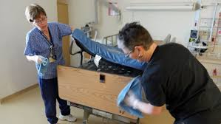
Work Experience Option (WE)
Short term work experience in entry-level employment (e.g., dietary, housekeeping, laundry) while in CNA class
Benefits for students:
Learn about employer culture
Develop employment and interpersonal skills
Meet potential co-workers
Benefits for employer:
Future workforce development
Workers learn various aspects of business
Increased capacity
WorkForce/PIC pays the salary of participants

Slide 18
Minnesota West Community and Technical College
MN West instructor provides required informational and skills training. Schedules “clinicals” where the student gets experience working in a healthcare facility. And finally getting the student through the “test out” which incudes a written and skills test. These must be passed before CNA Certificate will be issued by the state.
5 Campus Locations
2 Education Sites
Over 70 major degree programs
Customized training/continuing education
Only 2-year higher education institution in the region
Collaborate with Southwest Minnesota State University – the only 4-year university in the region

Slide 19
Marshall Public School District
Benefits to the School District:
Full classes and more classes offered per year
Increased Community Respect
Development of new Career Pathway trainings
Benefits to the High School (HS) Students:
Added support offered to the HS students that is available to adults
Creates a more realistic workplace experience
Adults gain “technology” skills from the HS students
HS students gain a “workplace mindset”
Breaks the cycle of poverty

Slide 20
Employers – Marshall and the Surrounding Communities
Employer Driven: employers provide input on what their special needs are. These needs are then incorporated into the CNA training along with the required educational and skills components.
Employers give input through an Employer Panel where the employers discuss with the students what they are looking for in a good employee. These discussions address training, interpersonal skills, workplace ethics, and job skills. Students are given the opportunity to ask questions.
A WorkForce/Private Industry Council navigator meets with the CNA class at various times during the training to work with the students on employability skills. Employers give input to the navigator when preparing for these presentations.

Slide 21
Innovation: Gives Success
Co-Mingled Adult/Youth Training
How the Model Began in the Summer of 2016
Created out of need. The need was to deliver CNA trainings in the most cost efficient manner.
Cost of class delivery same regardless of class size.
Challenge to recruit enough adult participants to fill a class due to low unemployment and other factors.
Maximize efficient use of resources.
Based on governor’s World’s Best Workforce Mandate.
Public Schools now have a focus to offer Career Pathway trainings.
Integrated setting for high school, college, and adult participants reflecting the real workplace.
Uses Marshall Public school general funding – not as limiting as PSEO.
Managed requirements for blending adult & youth participants (background checks for adults).

Slide 22
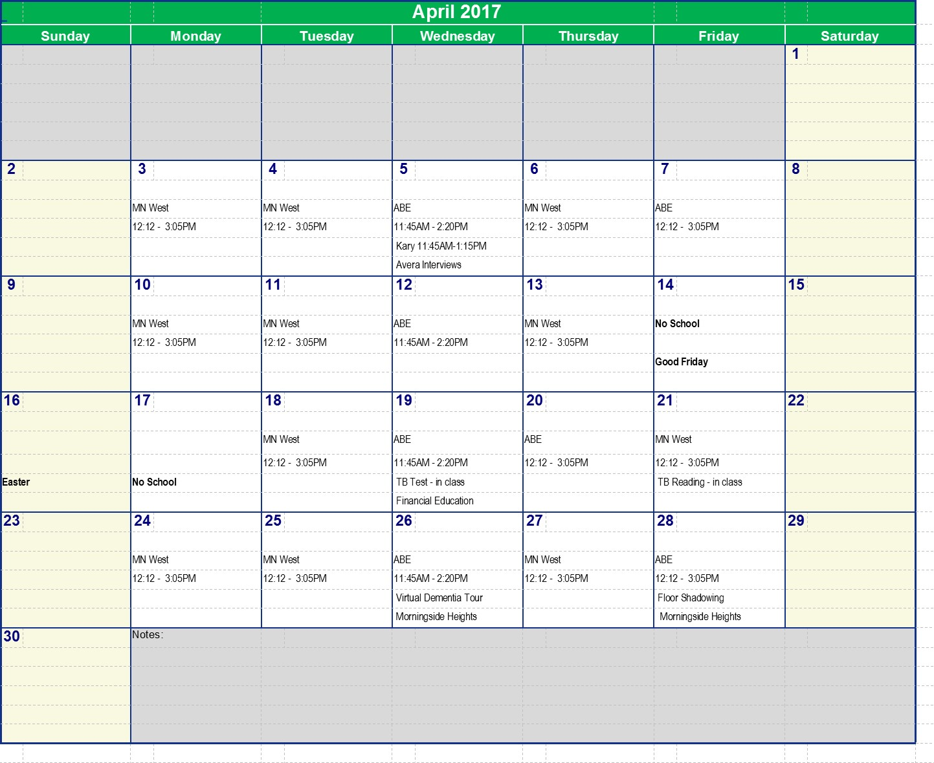
Typical Schedule
MN West/ ABE
12:12 – 3:05
designates what instructor will be teaching that day and the class time. MN West days are when new instruction and skills are presented by the MN West instructor. On ABE days an instructor provided by ABE is present to give extra support and practice to the students. Additional activities presented by the employers are also scheduled.

Slide 23
The CNA training content is
“Employer Driven”
The presentations, tours and panels were created from needs seen by the employers beyond what the class time training provided.
WorkForce/PIC (job skills)
Financial Education
Virtual Dementia Tour
Floor Shadowing
Nutrition Class
Employer Panel
Family Panel
MN West/SMSU Presentation on continuing education in the health care field
TB or Mantoux Testing is provided free by an employer

Slide 24
Three Factors that Influence our Successful
Career Pathway Training
Factor Two:
Focus on
Student Success
Factor One:
Real Collaboration
Factor Three:
Employer Driven Trainings

Slide 25
Sustainability –
Everyone’s Greatest Challenge
Funding Career Pathway Program Delivery with Braided Funding
Braided Funding: The process of combining funds from different sources to support an individualized set of services so that expenditures from each source can be tracked and applied to specific individuals eligible for that funding.
Collaborating Organizations funding sources:
Pell grants
Community grants
Federal & state program funding
Local school district funds
State re-imbursement legislation
Employer contributions
ABE funds
Student Self-Pay

Slide 26
Collaboration Sustainability
Be willing to try new funding flavors as they present themselves -
flavors that do not require “grant” funding.
CNA reimbursement law
Asking for employer contributions
New Work experience opportunities for Adult (PIC) CNAs – the goal being the CNAs become full-time employees

Slide 27
CNA Reimbursement Law
For detailed information go to
http://www.southwestabe.org/cna-reimbursement

Slide 28
Innovation: Gives Success
Reading Skills for Healthcare Workers
A free online Career Pathway literacy curriculum based on CNA and general healthcare content
http://southwestabe.wix.com/rsforhealthcare
The CASAS reading cut off score for the CNA training is 230.
This curriculum is used when the student’s score is below the 230.

Slide 29
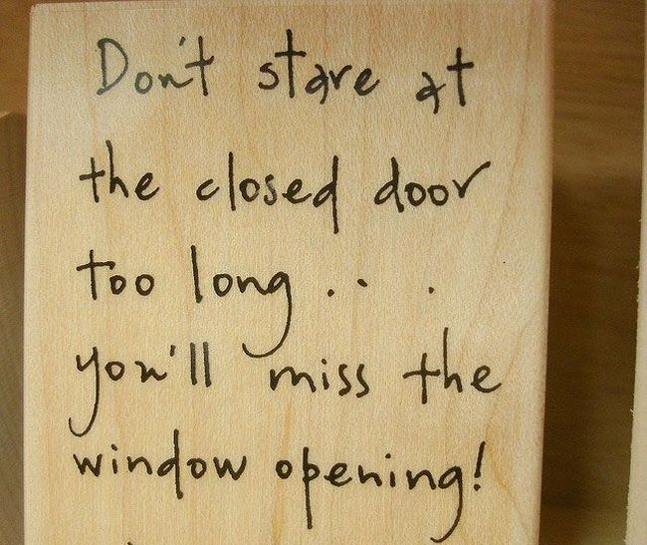
When faced with possible hardships, focusing on a positive attitude and being open to new ways of collaboration becomes even more critical!
When the doors are closed, windows are opened.
Your Attitude will determine if you can see the open windows.

Slide 30
Everyone brings an Ingredient to the Soup!
A Recipe for Success
In summary I am here to confidently state that collaboration (real collaboration) and innovation create success for your students.
Wisdom from “Been around the block”:
Focus on your client and his/her success
Be aware of other agencies who have clients that share this common goal
Be open to new ideas
Be willing to seize opportunities as they present themselves
Allow the employers to Drive the training content
I can assure you our students are receiving better services due to our collaborations – not duplicating services! And that is what WIOA is all about.
The recipe is always reinventing itself.
New Ingredients = New Successes

Slide 31
Next Step- Homework

Slide 32
Homework
Find your local ABE & WorkForce Programs
Contact your local ABE & WorkForce Programs
See what they are offering
Inform them of your needs

Slide 33
Good Luck
If you should have any questions or issues please feel free to contact one of us:
Pat Thomas – SW ABE Director
pthomas@starpoint.net
Jason W. Swanson – Tealwood Regional Operations Director
jason.swanson@twsl.com

