Slide 1
Combine Collaboration
and Innovation
Voila!
A Recipe for Success
Ingredients: Collaborating Partners
Success: Innovating Ideas
To provide
Excellent Services to our Customers
August 15-17, 2018, St. Cloud Civic Center

Slide 2
Three Factors that Influence our Successful
Partnerships
Factor Two:
Focus on
Customer Success
Factor One:
Real Collaboration
These factors will be high lighted during the presentation.
Factor Three:
Employer Driven Trainings

Slide 3
What makes the Partnership work?
The Partners are
Invested in a Common Focus.
The Customer is the Focus.
It takes all the Partners to
Make the Customer Successful.
And all Partners
Benefit from the Customer’s Success
We All Do !!!

Slide 4
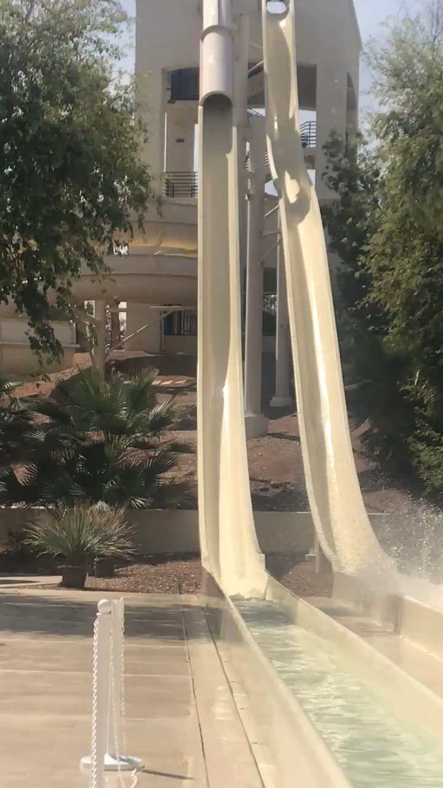
Ready to Take the Plunge?
acCepting Less than Perfect
Exciting
Losing Control
Amazed
Risk Taking
Brand New Feeling
Sense of Accomplishment
Can you Work Outside the Silo?
Seeing Customers receive a better service

Slide 5
For the purpose of this presentation we will primarily focus on our Career Pathway Training in Health Care – Certified Nursing Assistant Training.
Other Career Pathway trainings we offer in our region:
Medical Terminology – 2 college credits
Trained Medication Administration – Employer recognized credential
Welding – 6 to 16 college credits depending on the length
Community Interpreter – Recognized credential
Machine Tool – 4 college credits
Mechatronics – 4 college credits
Electronic Controls – 2 college credits

Slide 6
What do Healthcare Collaboration Partners look like?
We are better at providing services because all of us know we CAN NOT do it by ourselves!!!!
We are not the only tools in the drawer.
Morningside Heights
Assisted Living

Slide 7
Collaboration –
Definition, Test, and What it looks like to us
Definition: To cooperate with an agency or instrumentality with which one is not immediately connected.
Test:
Do you function differently due to your collaboration?
Where is your focus?
Can you operate “as a work in progress” or like you are creating a recipe as you go along?
How much do you set as a priority in the creation of relationships outside your agency?
What it looks like to us:
A new Mindset: I am invested in the success of my partners in order to ensure success for my program and customers.

Slide 8
Building the Plane While It’s Flying
Keep moving forward
and adapting when changes are needed

Slide 9
Real collaboration requires
Flexibility and Adaptability.
It is like having to come up with a meal using surprise ingredients from the “Chopped” mystery basket.
Examples:
Schedule for Career Pathway trainings done with youth.
Legislation providing CNA training reimbursement to agencies.
Employer brainstorming with Home and Community Based Scholarship grants.

Slide 10
If you only focus on your program goals,
you miss many opportunities—opportunities captured when creating from a more diverse menu for the common customer.
Care Provider and potential legislative funding to create an online literacy-based curriculum for healthcare workers.
Financial support from healthcare facility to offer CNA trainings.
Online career assessment through the college
Work experience from PIC

Slide 11
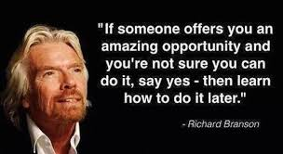
How did we plan for our successful services to our students?
Factor One:
Real Collaboration
Factor Two:
Focus on
Student Success
We are open to seize opportunities as they appear.
Sir Richard Charles Nicholas Branson is an English business magnate, investor and philanthropist. He founded the Virgin Group, which controls more than 400 companies
Factor Three:
Employer Driven Trainings

Slide 12
Essential Ingredients
Healthcare Employers
(driving the training content)
CUSTOMER SUCCESS

Slide 13
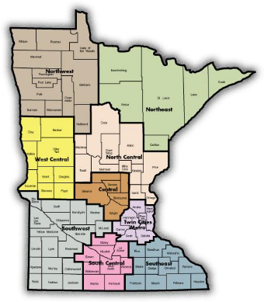
Where we are cooking and what we have to offer
Primary Industry Sectors
Agriculture Healthcare
Manufacturing Energy
Transportation Finance/Banking
Government Food Processing
22 Rural Counties (Approximately 25% of the state)
Population: 163,410 State Population: 5,344,861
Two Regional Centers
Marshall Population 13,000 Worthington Population 12,000
In this region livestock out number human beings.
*Marshall
*Worthington

Slide 14
Regional Facts Influencing Partnerships & Collaborations
Population decline & low population density
Influx of international immigrants/refugees requiring specialized services
Very low unemployment rates (2.9%)
Shortage of skilled workforce
Large geographic area/distance between communities
Lack of public transportation
Limited child care providers

Slide 15
Collaboration Foundation Ingredients
WorkForce/Private Industry Council
SW Adult Basic Education – Marshall Region
MN West Community and Technical College
Marshall Public School – MATEC
Community Employers
Community
Employers

Slide 16
Foundation Ingredient
SW Adult Basic Education
ABE’s Role
Point of contact for collaboration customers
Assessment: reading, math, computer skills
Customer literacy development focus
Customer recruitment for training programs
Prepare customers to take CNA training through an on-line more independent format
ABE’s Value Gained:
More frequent and a wider variety of trainings
Provides an entry-level position opportunity for immigrant/ESL students/underemployed or unemployed customers.
SW Adult Basic Education
Marshall Granite Falls Worthington/Jackson
3 Regional Directors (to be reduced to 2 in near future)
55 Instructors—Majority are part-time

Slide 17
Foundation Ingredient
Southwest WorkForce Center
The Navigator
Handles customer intake, eligibility determination, file maintenance, career plan identification; provides tailored support services; helps customer navigate the various resources available to help overcome barriers to success; and serves as WE/OJT developer and business liaison.
Promotes and ensures that the customers have a positive experience and achieve success related to the specific training, job search preparation and placement.
PIC navigator works with customers both in the classroom and individually as needed to help build employability skills.
Southwest WorkForce Center
Regional Office Locations
Marshall – Montevideo - Worthington
WorkForce Center Partners
Southwest MN Private Industry Council (PIC)
-WIOA Title 1 (workforce development)
Job Service
-WIOA Title III (Wagner-Peyser – labor exchange, unemployment insurance, business services)
Department of Rehabilitation Services/State Services for the Blind
-WIOA Title IV
Veterans Services

Slide 18
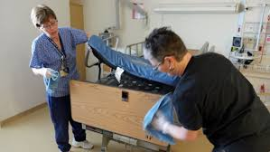
Work Experience Option
Short term work experience in entry-level employment (e.g., dietary, housekeeping, laundry) while in CNA class
Benefits for customers:
Learn about employer culture
Develop employment and interpersonal skills
Meet potential co-workers
Benefits for employer:
Future workforce development
Workers learn various aspects of business
Increased capacity
WorkForce/PIC pays the salary of customers

Slide 19
Foundation Ingredient
Minnesota West Community and Technical College
MN West instructor provides required informational and skills training. Schedules “clinicals” where the student gets experience working in a healthcare facility. And finally getting the student through the “test out” which incudes a written and skills test. These must be passed before CNA Certificate will be issued by the state.
5 Campus Locations - 2 Education Sites
Over 70 major degree programs
Customized training/continuing education
Only 2-year higher education institution in the region
Collaborate with Southwest Minnesota State University – the only 4-year university in the region

Slide 20
Foundation Ingredient
Marshall Public Schools
Marshall Public Schools provides the classroom space and high school students to keep the trainings full and have more trainings per year. Plus we can offer a wider variety of trainings due to continuing with Youth and Adults

Slide 21
Foundation Ingredients
Community Employers
Employers are a Critical partner to our process.
Our success is due to the fact we ask Employers to "drive" the content of our trainings!
The Employers benefit from having a pool of employees with the skills they want and need.
Employers have direct access to creating trainings to meet their needs.

Slide 22
Employer Driven Training
Employer Testimonial
LINCS Presentation from Policy to Practice
Pat Mellenthin, CEO
Prairie Home Hospice & Community Care
Marshall, MN
We feel that we are a partner in the training program and play an active role in helping to drive a program that will meet our needs.
We feel that we are a partner because we are consistently invited to play an active role in identifying the needs and gas in order to design training/curriculum that meets the needs of those who are hiring.
This helps to ensure that the training program provided the training the students need to become highly qualified for the positions that employers are seeking to fill
We are then continually asked to provide feedback in evaluating the program and/or offering ideas to improve upon it.
The key is not only the invitation, but the strong partnership and trust that has developed because Pat (and others involved in the program) have consistently demonstrated that our partnership ad feedback is genuinely valued, and truly does play a significant role in driving the program.

Slide 23
Employer Driven Training
Employer Testimonial
(continued)
As a partner, we have offered paid internships to customers and have offered employment to graduates.
We have found that those we have hired are well trained for the jobs we have available.
In general, they make strong candidates because of the training they have received.
We know the training they received reflects our needs, because we played a role in ensuring the curriculum met those needs.

Slide 24
Employer Driven Training
Employer Testimonial
(continued)
As the CEO, I have supported the program and provided input/feedback periodically. Our Human Resource and Clinical Director are also actively involved. I believe many of the other employers involved feel as we do…without this training program in our community, the pool of qualified candidates available to fill the need for well-trained CNAs/TMAs in our community would not meet the need. In recognizing the value of this program, we (like many of the partners) are committed to supporting the program financially in order to ensure that the program is sustainable. I believe that this financial commitment reflects the true sense of ownership that many of the employers feel.

Slide 25
Employer Driven Training
Marshall, MN
Heritage Pointe Senior Living
Prairie Home Hospice & Community Care
Avera
Boulder Creek and Stepping Stone Home Health Care
Minneota, MN
Minneota Manor
Tracy, MN
Prairie View Homecare Center
Balaton, MN
Colonial Manor
Avera, Boulder Creek, and Stepping Stone Home Health Care partnerships formed out of a need for qualified care in our assisted living and memory care facilities.
Community Employers

Slide 26
Employer Driven Training
Community Employers
Additional Benefits
Stepping Stone Home Care Center has offered the assistance of a Registered Nurse to teach the training
Boulder Creek’s activity department has students assist with activities with dementia clients
All Employers have given feedback on the new program, ‘Reading Skills for Health Care Workers’
Avera Marshall has set up the virtual dementia tour and has provided financial assistance for on-the-job training in its facility
Prairie Home Hospice gave internships to 2 immigrant nurses from Egypt.

Slide 27
Innovation: Gives Success
Co-Mingled Adult/Youth Training
How the Model Began
Created out of need. The main need being qualified staff to care for the seniors in our assisted living, memory care, and nursing facilities.
Cost of class delivery same regardless of class size.
Challenge to recruit adult customers due to low unemployment and other factors.
Maximize efficient use of resources.
Based on governor’s World’s Best Workforce Mandate.
Re-vitalize career technical training now exists in Public Schools.
Integrated setting for high school, college, and adult customers reflecting the real workplace.
Uses Marshall Public school general funding – not as limiting as PSEO.
(Some schools are using a waiver for PSEO to fund this)
Innovation is the process of translating an idea or invention into a good or service that creates value

Slide 28
Innovation: Gives Success
Co-Mingled Adult/Youth Training
These presentations, tours and panels were created from needs seen by the employers beyond the training provided.
WorkForce/PIC (job skills)
Financial Education
Virtual Dementia Tour
Floor Shadowing
Nutrition Class
Employer Panel
Family Panel
MN West/SMSU Presentation on continuing education in the health care field
TB or Mantoux Testing is provided free by an employer
The model is forever being tweeked to meet current needs!

Slide 29
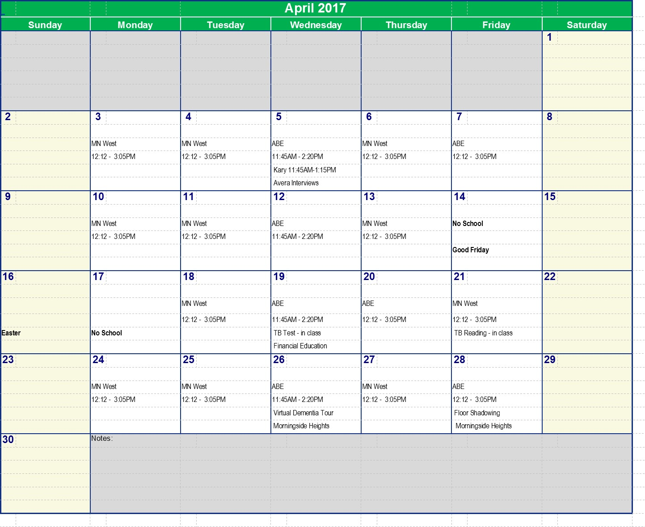
Typical Schedule
MN West/ ABE 12:12 – 3:05
designates what instructor will be teaching that day and the class time.
Navigator (job skills), Financial Education, Virtual Dementia Tour, Floor Shadowing, Clinicals, Nutrition Class, Employer Panel, etc.
The CNA training content is “Employer Driven”.
These are the special field trips and mini trainings that are presented on ABE days to prepare the students for employment after completing their CNA training

Slide 30
Innovation: Gives Success
Co-Mingled Adult/Youth Training
Value Gained from Co-Mingling Adults and Youth
Learning environment replicates work environment with multi-generations
Improved literacy rates for comprehension, math and digital literacy
Adults learn technology & classroom skills from youth
Multiple funding sources & classroom/administrative support
Multiple sources of student recruitment to fill class requirements
Strengthens self-confidence; builds self-esteem/career mindset
Achievement of high school and college credits
Adults and youth gain mutual respect
Breaks the cycle of poverty

Slide 31
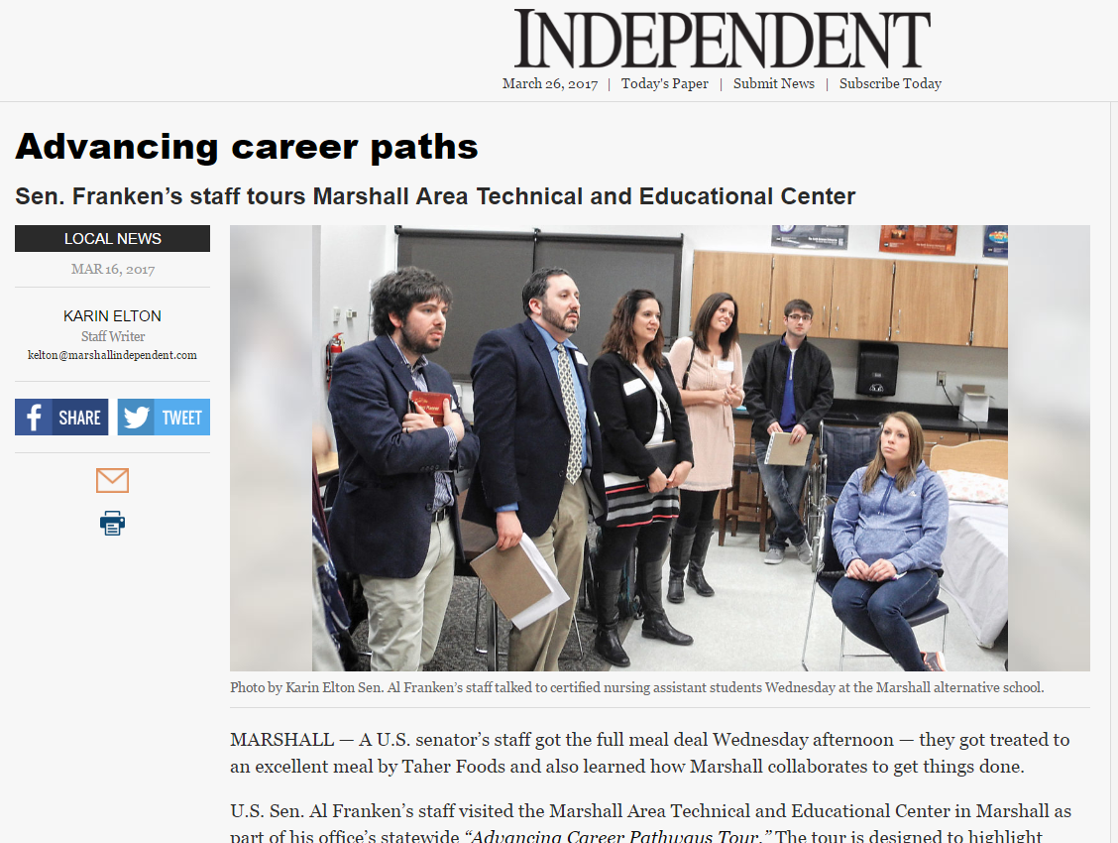
“Franken staffer Solomon said they have been to high schools all around the state and this is the first one they have come across to ‘incorporate ABE.’”

Slide 32
Sustainability – Everyone’s Greatest Challenge
Funding Career Pathway Program Delivery with Braided Funding
Braided Funding: The process of combining funds from different sources to support an individualized set of services so that expenditures from each source can be tracked and applied to specific individuals eligible for that funding.
Collaborating Organizations funding sources:
Pell grants
Community grants
Federal & state program funding
Local school district funds
State re-imbursement legislation
Employer contributions
ABE funds
Customer Self-Pay

Slide 33
Collaboration Sustainability
Be willing to try new funding flavors as they present themselves -
flavors that do not require “grant” funding.
CNA reimbursement law
Asking for employer contributions
New Work experience opportunities for Adult (PIC) CNAs – the goal being the CNAs become full-time employees

Slide 34
Innovation: Creates Success
CNA Reimbursement Law
For detailed information go to
http://www.southwestabe.org/cna-reimbursement

Slide 35
Innovation: Creates Success
Reading Skills for Healthcare Workers
A free online Career Pathway literacy curriculum based on CNA and general healthcare content
http://southwestabe.wix.com/rsforhealthcare
The CASAS reading cut off score for the CNA training is 230. This curriculum is used when the student’s score is below the 230.

Slide 36
Innovation: Creates Success
Reading Skills for Healthcare Workers
Sample Selection Titles
Mr. Howe’s Pneumonia
Recognizing Signs of Elder Abuse
Resident Rights in Nursing Homes
Samantha Learns about HIPAA
What is Dementia?
The Five Principles of Care
Breaking the Chain of Infection
Developing Cultural Competence
Taking Vital Signs
Performance Evaluation
Healthcare Settings
Planning for a Successful Job Search
End of Life Care for Mr. Stephens
Content Vocabulary
airway obstruction
body mechanics
care plan
Fowler’s position
hygiene
intake
pathogens
respiration
scope of practice
HIPAA
health care directive
High-Utility Academic Vocabulary
adequate
condition
trigger
protocol
evaluate
factor
indicate
maintain
minimize
transition
decline
175 selections for intermediate-level readers between 5.5 and 8.5 grade levels
Selections focused on healthcare-related content written by licensed language arts/ESL teachers, most with pre-CNA teaching and course development experience
Focus on academic and content vocabulary with comprehension questions and writing prompts
Readability is measured by ATOS for College & Career Readiness alignment
All selections recorded in 3 speeds for fluency modeling

Slide 37
Innovation: Creates Success
Reading Skills for Healthcare Workers
Included with each reading selection:
Pre-reading questions
Pre-reading definitions of healthcare and high utility vocabulary
3 speeds of recorded text for learners to listen to for fluency development
Selection focused on healthcare-related content for engagement and motivation
Text dependent questions for understanding.
2 writing options
1 text dependent
1 more open ended

Slide 38
More Collaboration Success!
Reading Skills for Healthcare Workers
$25,000 grant to expand to RSHW levels 5.0 & 4.5

Slide 39
More Collaboration Success!
The Successes just keep coming…
DEI Grant
Learning thru Sharing
Marshall Adult Literacy
SMSU Partnership
Schwan’s Project
Adobe Connect to deliver ABE Services
Rural Career Pathways Legislative Project: www.lyftpathways.org

Slide 40
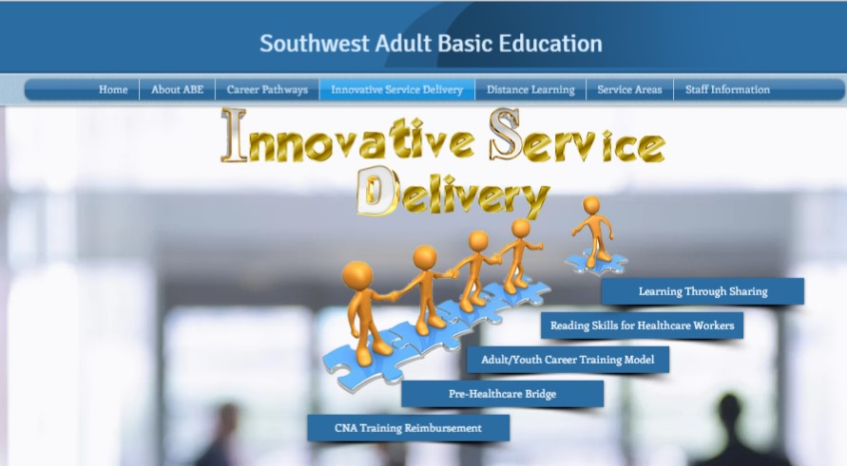
To get more information about our successes…….
1.
www.southwestabe.org
2.
3.

Slide 41
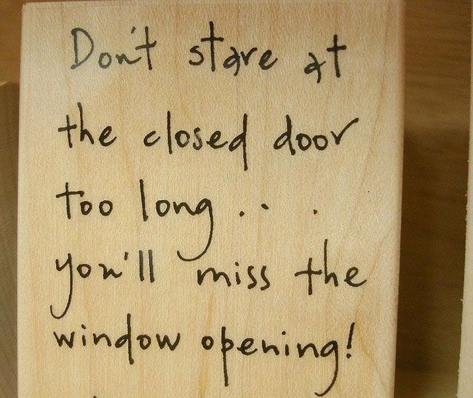
When faced with possible hardships, focusing on a positive attitude and being open to new ways of collaboration becomes even more critical!
When the doors are closed, windows are opened.
Your attitude will determine if you can see the open windows.

Slide 42
Voila!
A Recipe for Success
In summary I am here to confidently state that collaboration (real collaboration) and innovation create success for your customers.
Wisdom from “Been around the block”:
Focus on your customer and his/her success
Be aware of others who share that customer’s success as a focus from other agencies
Be open to new ideas
Be willing to seize opportunities as they present themselves
Allow the employers to Drive the training content
I can assure you our customers are receiving better services due to our collaborations – not duplicating services! And that
is what WIOA is all about.
The recipe is always reinventing itself.
New Ingredients
=
New Successes

Slide 43
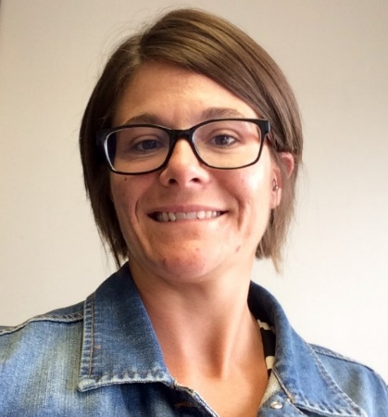
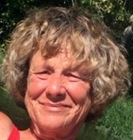
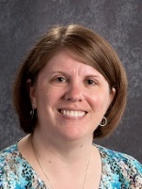
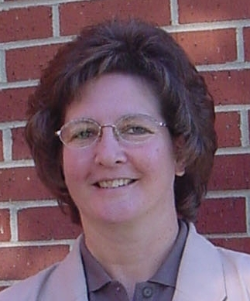
Pat Thomas
Director
SW ABE Marshall Region
pthomas@starpoint.net
Eriann Faris
Youth Program Manager
SW MN Private Industry Council (PIC)
efaris@swmnpic.org
Leanna Ginocchio
Administrative Assistant
Marshall Area Technical & Educational Center
leanna.ginocchio@marshall.k12.mn.us
Dawn Regnier
Director of Customized Training/Continuing Education
Minnesota West Community and Technical College
dawn.regnier@mnwest.edu

